Slide 1
United Nations Office On Drugs And Crime (UNODC)

Slide 2
Table of Contents
Letter from the Chair
Introduction to the Committee
Topic 1: Illicit Drug Markets In The Midst Of Covid-19
Introduction
Explanation of the Problem
Focus of the Debate
Questions to Consider
Glossary Of Terms To Know
Recommended Readings
Bibliography
Topic 2: Combating Money Laundering And Asset Forfeiture
Introduction
Explanation of the Problem
Focus of the Debate
Questions to Consider
Recommended Readings
Bibliography

Slide 3
Letter from the Chair
Dear Delegates,
A warm welcome to all of our participants for this year's rendition of the UNODC! This is your chair speaking, Gerald, and I'm pleased to allow you into our committee! To cut straight to the chase; MUN's was an essential part of my high school experience not only where they a fun extracurricular activity that boosted my CV but they also made me more aware of today's most pressing issues. Even if you were a bonafide-expert in diplomatic connections, chances are MUN's will still ask you to put your money where your mouth is in its challenging yet rewarding environment. Whether you are a new time beginner who couldn't even pronounce the capitals of their allocated nation, or a veteran delegate with many awards under their belt, I will do my best that you walk out of this MUN room on the last day knowing that the event was at least fun.
Now with all the fun stuff shoved away, the UNODC is clearly no laughing matter. It is a branch of the United Nations that has primary focus on criminal activities and how we attempt to counter them, think Batman but without the traumatic past and instead of a costume a suit. I hope that everyone has an informational and entertaining conference and I’m looking forward to working with you all. Feel free to contact me if you have any queries!

Slide 4
INTRODUCTION TO THE COMMITTEE
For more than two decades, the United Nations Office on Drugs and Crime (UNODC) has been helping make the world safer from drugs, organized crime, corruption and terrorism. Committed to achieving health, security and justice for all by tackling these threats and promoting peace and sustainable well-being as deterrents to them have been long-lasting aims of this committee. Due to the fact that the scale of these problems is often too great for states to confront alone, the UNODC offers practical assistance and encourages transnational approaches to action. They do this in all regions of the world through the mechanisms of global programmes and a vast network of field offices and agents. The Office is committed to supporting the Member States in implementing the 2030 Agenda for Sustainable Development and the 17 Sustainable Development Goals (SDGs) at its core. The 2030 Agenda clearly recognizes that the rule of law and fair, effective and humane justice systems, as well as health-oriented responses to drug use, are both enablers for and part of sustainable development. Recognizing the importance of comprehensive, factual and objective information in the field of international drug control, the General Assembly entrusted UNODC with the mandate to publish "comprehensive and balanced information about the world drug problem" in 1998. The year 2004 saw the consolidation of the former Global Illicit Drug Trends publication and the World Drug Report, published in a two-volume edition. The first volume provides an analysis of the global situation and of the four main drug markets, whilst the second volume compiles detailed statistics. Together they provide the most complete picture of the world drug problem. By working together with other law enforcement and justice agencies around the world, the UNODC is doing its level best to reduce drug and organized crime around the world.

Slide 5
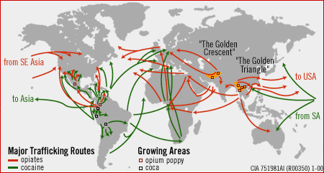
Committee: United Nations Office On Drugs And Crime
Topic: Illicit Drug Markets In The Midst Of Covid-19
Author: Gerald Lanz Castillo
Introduction
Living in the age where most have suffered greatly from the impacts of Covid-19, we have been made to understand the additive effects of how a wide-pressing issue can be swept under the rug without even a notice. One of these discussions lies in the recent uprising in drug cartels that much like the virus, has swept across the globe almost invisible to the public’s eyes. Similarly, many are unaware or are hazy of its transmissions and its effects on health, but there is no deception when it comes to the proliferation of its statistics as there are no lies in the many pieces of data that state that its impact on economic and social growth has gone up in flames.
Although restrictions on borders play a massive impact in preventing the drug trade, many sellers and buyers have begun using unconventional methods to move their resources around the world. It is your job as members of UNODC to investigate the sources of these drugs, intercept, and implement new laws that could further prevent this issue from escalating.
In around March 2020, the Corona Virus was officially recognized by the World Health Organization. This has severely crippled the drug trade system heavily in many fields and factors to consider, however it is no question that much like how we concern ourselves when it comes to attempting to fight back against the virus, many drug traders collectively decided that "Modern Problems Require Modern Solutions" and this leads into a more open discussion of how we can combat, disrupt and potentially end these illegal markets from opening up.

Slide 6
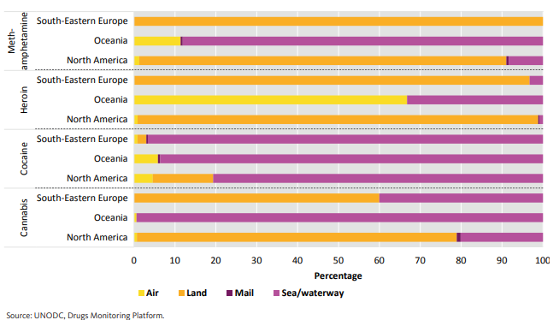
Explanation of the Problem
Land, Sea Or Air?
When one is concerned with how drugs are transported worldwide, one should be well equipped with how a drug supply chain works. A drug supply chain typically involves a series of personnel directly or indirectly related to the distribution of drugs from the very beginning of the process in its production and manufacturing to trafficking as well as its delivery. The worldwide pandemic has negatively impacted at least one of the following regions of the chain, but one of its most prominent changes lies in its travel. Restrictions on country travel during the start of lockdowns to prevent the spread of the disease have also played a part in the movement of the illegal substance. Further international developments called for an almost unanimous consensus for the shutting down of air travel, this leads to an immense difficulty for sellers to utilize drug mules as a means of drug trade due to transportation difficulties and an increase of security checks places additional pressure and risk. However, this method only plays an emphasis on the trafficking of the primary share of drugs in certain countries where it is less a secret operation and more a well-kept undercover operation.
On the other hand, the movement of these substances by sea cargo remains relevant and ongoing. Most likely this is from the reduction of air traffic so maritime seems like it would yield a better chance of delivery to the drug consumers. Look no further than recent reports in Colombian and European reports to see the effects of smuggling of cocaine rising to an all-time high following a dip in sky travel.
When it comes to international borders a range of outcomes have shown a positive and negative development. For starters the closing of borders within the nation of Czechia and the Western region due to a reduction of the availability of methamphetamine as well as crossing borders for sellers-and-buyers respectively. Despite this, to some degree usage of law enforcement used to curb the spread of Covid-19 (as well as other activities) has directed away resources from anti-narcotics devivisions that has created an environment for traders to utilize this blindzone.

Slide 7
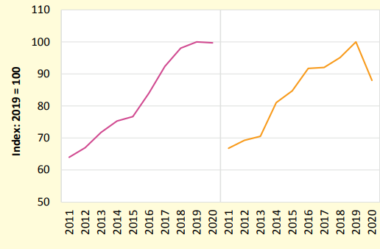
Explanation of the Problem
Production Problems and Manufacturing Mishaps; Everything is satis”factory”.
Despite the initial disruption from the effects of lockdown and isolation, the production of drugs seemed to not suffer greatly. Synthetic Drugs were relatively untouched throughout the pandemic and the increase of opiate-induced seizures within the continent of South East Asia seemed to support this claim, with further reports from law enforcement in European countries also proving this (In addition to Cannabis Cultivation). But for the regions of North America and Europe where precursor materials for manufacture is required due to mobility issues to its decline in production and spike in prices.
Cocaine in Latin America areas (most prominently in Peru and Colombia) had a preliminary difficulty in the early stages of lockdown when buyers could not reach the regions of coca leaf cultivation but once restriction was eased most of the adverse issues were resolved. Research data converys that most of these exports seem to reach European Nations with a notable case being in February 2021 when 16 tonnes of cocaine were seized at Germany in Hamburg with an addition 7.2 also being intercepted in the port of Antwerp in Belgium.
“Crack”ing down the trends in consumption
The economic market fluctuations during lockdowns greatly deviate from the changes in drug market patterns. With the economic recession and revival in drug use due to isolation as a method of escapism, recreational use of narcotics is heightening. Although it would be a correct assumption that the frequency of meetings between buyers and sellers would prevent a further increase in drug use, studies show that instead consumers resort to riskier activities to either cope up with addiction or try out the drugs for 'fun'. Such include pre-purchasing syringes containing the contraband which may be contaminated as well as sharing it between individuals. However such trends can vary from country to country as shown by a discrepancy in Europe where wastewater analysis seemed to suggest a decrease in consumption some drugs.

Slide 8
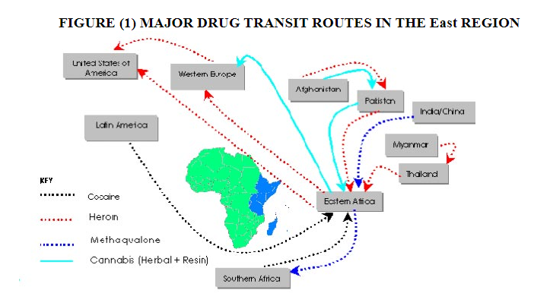
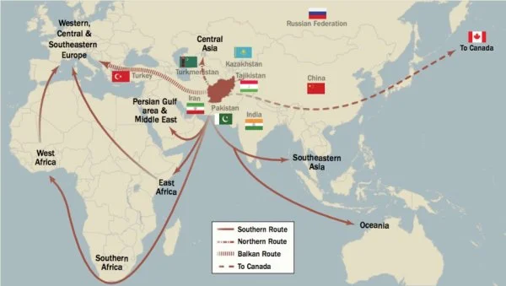
Explanation of the Problem
South America: When it comes to travel, none uses the maritime method as effectively and efficiently as Latin America. According to figures, almost 90% of cocaine is transported via this route at one point, syndicates have made use of multiple various complicated systems to fly under-cover from the eyes of law enforcement. But what makes the groups of nations one of the most notorious when it comes to trafficking is its numerous drug cartels that are dubbed "The Greatest Organized Crime Threat". The 3 main routes for trafficking are the "Caribbean, Pacific and Atlantic Routes".
African Region: Eastern Africa has become a central hub for trafficking with some of its most transported drugs being heroin, cocaine and cannabis to name a few. It is a region that has become synonymous with a lack of proper focus on the drug trade, pair this with a nearly non-existent border security and a shaky criminal justice system and we have an attractive spot for syndicates to exploit the system. Some of its trading routes direct towards South-West and South-East Asia which mainly utilize air travel, a growing trend indicates an increase in the trafficking of heroin towards Pakistan, Thailand as well as India.
Central Asia: The country of Afghanistan to date is the primary player when it comes to anything Opium, this is mainly helped by its extensive trade routes that span multiple regions such as Pakistan, Iran And Russia. Its Balkan route is estimated to have an annum every year of about USD 28 billion that shockingly making up slightly more than one-third of its nation's GDP. Fortunately, many legislations are attempting to adverse the effects although it is debatable whether these efforts will hold true to their aim.

Slide 9
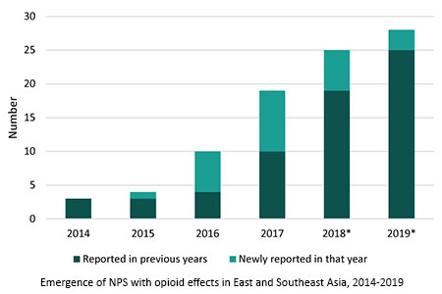
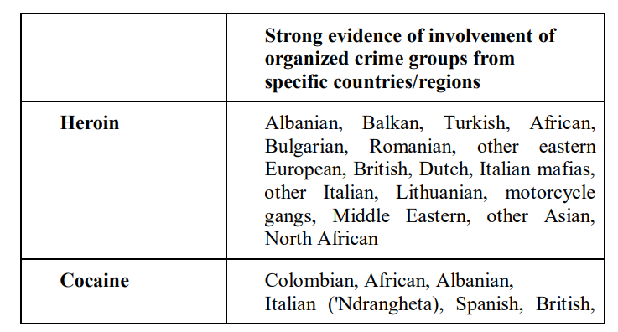
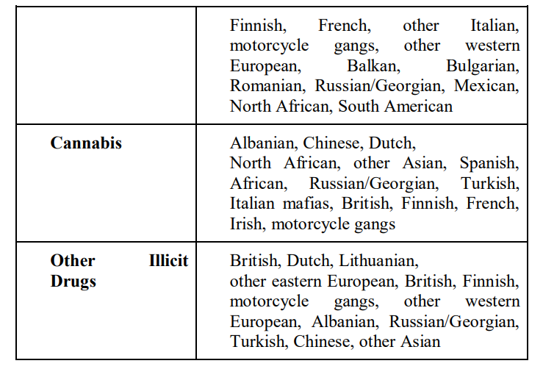
Explanation of the Problem
Southeast/East Asia: Similarly, when it comes to an emphasis on newer technology and the resurgence of synthesized medication Southeast and East Asia is one of the frontrunners when it comes to artificially created drugs. Methamphetamine is one of the best sellers on the continents with its price being at an all-time low to reflect its massive supply and demand. The pandemic proved to be ineffective in disrupting the production and trafficking of dangerous illegal substances, worryingly more emerging routes have been formed between the countries that intensified the issue.

Slide 10
Focus of the Debate
Role of COVID-19 pandemic on drug supply in respective nations
The committee aims to first and foremost address the underlying effects that the pandemic has done on the drug world, ranging from how suppliers deliver their contraband to how law enforcement at borders either toughens up in response to pressure from restrictions or weakens due to a greater focus on dealing with covid-19 issues first. Addressing the trends of consumers and patterns will lead you in the right direction of how we can even consider how to solve this problem.
Implemented regulations to prevent further trading of illegal drugs
(Almost) The entire world acknowledged the seriousness of the covid-19 virus and had implemented regulations to counter its spread. But little to no emphasis has been placed on the underground trafficking of drugs during this time frame. Fortunately, some nations upon having a safe space to take a breather from the pandemic explored the notion of fixing the problem. It is of great significance that you know what your country has done to alleviate the issue not only in the respective state but also what has it done to prevent state actors worldwide from continuing the cycle.
Interception of Drugs in changing times
It is recommended that delegates be made aware of the trade routes in their nations both internationally known as well as undercover. To put it into greater detail where the productions are coming from, and exporting goes too as well as how they travel and whether individuals like drug mules are involved. Emphasis and good knowledge in this field will prove to be effective when constructing a final resolution as you would need to consider all angles of attack.

Slide 11
Focus of the Debate
Nationwide Cooperation
Trust and collaboration are the utmost skills that any MUN (Or UN for the matter of fact) requires. Considering that this topic may span both your allocated country and others as well, you must consider the means and methods related to how international relations work between your committee members. This will ensure that once the unmoderated caucus starts you can form blocs with nations that you see fit with working with and are willing to ally to support your cause. We wouldn't want sparks to fly between clashing members with varying ideas (although it would be a fun display for the chairs to enjoy).
A Blank Slate
Numerous attempts have been tried and tested before lockdown to combat the issue with varying degrees of success, but once restrictions were placed most of these laws were essentially wiped away and most nations had to start from scratch due to a changing environment. To ensure that history doesn't repeat itself we must understand how the international community ensures that momentum is maintained in a drug policy reform as well as how the monitoring and evaluation process can be harnessed to ensure effective implementation.
Community Consensus
Although most of our proposed solutions focus solely on those we associate directly with the drug trade like cartels and illegal sellers we must also take into consideration those who have been forced into illegal production or intercepted drug mules that risked their lives for payment. Although this committee focuses solely on crime, to only consider this is to lose the sole emphasis on a UN goal in maintaining a long-term plan as opposed to a short one.

Slide 12
Glossary Of Terms To Know
Cannabis: A psychoactive drug made from the leaves of the cannabis plant. Marijuana and hashish are the most common forms. Effects of cannabis on a user include euphoria, altered sense of time, difficulty concentrating, and poor short-term memory.
Cocaine: A powerful stimulant drug made from the coca plant. Cocaine (powder form) and crack (rock form) are the most common forms of the drug. Cocaine users often experience extreme alertness, energy, paranoia, and hypersensitivity to light and/or sound.
Convention Against the Illicit Traffic in Narcotic Drugs and Psychotropic Substances: A more serious convention about drugs in 1988 mandating international cooperation on cartels and recommending individual stronger action against drugs.
Convention on Psychotropic Substances: A 1971 convention that essentially added amphetamines and other synthetic drugs to the provisions of the Single Convention.
Destination country: A country for which drugs produced for export are bound. Often wealthier countries with high demand for drugs like the United States, United Kingdom, or France.
Global Conference on Illicit Drugs: An INTERPOL conference held every year to discuss police techniques regarding drug trafficking and to update INTERPOL databases.
Golden Crescent: A region known for opium cultivation at the crossroads of South, Central, and West Asia. Compared to the Golden Triangle.
Golden Triangle: A region known for opium cultivation at the border of Thailand, Laos, and Myanmar. Compared to the Golden Crescent.
Meng Hongwei: Former president of INTERPOL indicted by China in 2018 on bribery charges.
Methamphetamine: Highly addictive, a synthetic stimulant that appears as crystals. Users experience a high involving a faster heartbeat, faster breathing, and increased blood pressure.
“Moralistic” drug policy: Drug policy that views drug use as “immoral” and attempts to rid the country of use and trafficking. Sweden is a country with a moralistic drug policy.

Slide 13
Glossary Of Terms To Know
Operation Folosa: Massive INTERPOL training program and initiative with UNODC targeting drug trafficking in Latin America, Europe, Africa, and Asia.
Opiates: Addictive, narcotic substances derived from the opium poppy. Heroin, fentanyl, and morphine are all examples of opiates. Opiates relax the user and act as painkillers.
Project AMEAP: INTERPOL drug trafficking response project in Asia, The Middle East, and the Pacific.
Project Crimjust: Similar to Project AMEAP but in Latin America and the Caribbean.
Single Convention of Narcotic Drugs: UN treaty in 1961 that was designed to limit the sale and possession of drugs. Also developed the “schedule” system of classifying drugs.
Source country: A country from which drugs are usually grown or prepared for international distribution. Source countries may also be transit or destination countries. Source countries include Afghanistan, Colombia, and Myanmar.Just because a country is a source country does not mean that drug addiction and consumption are not a problem in the country.
Synthetic Drugs: All drugs of abuse that do not come from plant products or diverted pharmaceuticals could be categorized as synthetics. Based on their chemical composition, synthetic drugs are commonly divided into two categories: Cannabinoids such as K2, and Stimulants such as Bath Salts.
Transit country: A country through which drugs are trafficked en route to a destination country. Examples include Panama, Russia, and much of West Africa.
War on Drugs: A US policy began in 1971 by President Richard Nixon that aimed to curb drug use and trafficking by greatly increasing sentences for drug traffickers and users. Largely agreed to have failed in its objectives. The War on Drugs is also used to describe the international effort against drug use and trafficking.

Slide 14
Questions to Consider
The underlying cause and reasons for how undercover trafficking of drugs is still taking place even in these times.
The potential effects this crisis can have on the economical and social sector of not only your nation but world-wide as well.
How to ensure that further drug-based problems is not repeated in the future, and if so, how do we adverse the problem?
How can we ensure security is maintained?
How to increase the transparency between the nations to ensure that efficient and appropriate steps have been taken
What steps must be taken by all the states in diffusing the crisis
Your country’s political stance and action done on drug trade
How can the United Nations respond to the issue of illegal drug trafficking?
How can the international community proceed to the elimination of drug manufacturing and the illegal diaspora of drugs?

Slide 15
Recommended Readings & Bibliography
https://www.unodc.org/res/wdr2021/field/WDR21_Booklet_5.pdf
https://harmreductionjournal.biomedcentral.com/articles/10.1186/s12954-022-00601-z
https://www.emcdda.europa.eu/system/files/publications/13745/TD0321143ENN_002.pdf
https://www.unodc.org/documents/data-and-analysis/covid/Covid-19-and-drug-supply-chain-Mai2020.pdf
https://onlinelibrary.wiley.com/doi/10.1111/add.15620
https://www.ncbi.nlm.nih.gov/pmc/articles/PMC8303488/
https://www.unodc.org/unodc/en/press/releases/2020/May/covid-19-is-changing-the-route-of-illicit-drug-flows--says-unodc-report.html
https://www.unodc.org/unodc/en/drug-trafficking/central-asia.html
https://www.unodc.org/roseap/en/2020/05/regional-synthetic-drugs-report-launch/story.html

Slide 16
Committee: United Nations Office On Drugs And Crime
Topic: Combating Money Laundering And Asset Forfeiture
Author: Zayd Anis
Introduction
“Corruption, money laundering, and tax evasion are global problems, not just challenges for developing countries”. The idea of money laundering has been an ongoing crisis throughout history wherein to simply put, dirty money illegally travels through channels around the world, where at the end, it’s used for a multitude of activities; from funding drug deals, unwarranted construction projects, unlicensed sourcing of weaponry and so on.
Some conditions which can exacerbate the levels of how much money get laundered around the world include weakened local security agencies, widespread levels of corruption within governments, lack of unity in national parliaments to come to a unanimous point during formulating policies, turning a blind eye toward the justice system at present and other vested interests toward some individuals.
Unlike money laundering, asset forfeiture is a tool used by governments, which if conducted according to appropriate legal practices, can prove to be a clean and simple way to target individual criminals and other criminal organizations by simply seizing their assets. However, monetary watch dogs and other justice institutes have observed that this system has been riddled with heightened levels of corruption, not only in developing nations but also international superpowers such as the United States. These levels of corruption have often proven to notoriously snatch people’s livelihoods as thousands of dollars (or local equivalent), are simply taken away, without due explanation.

Slide 17
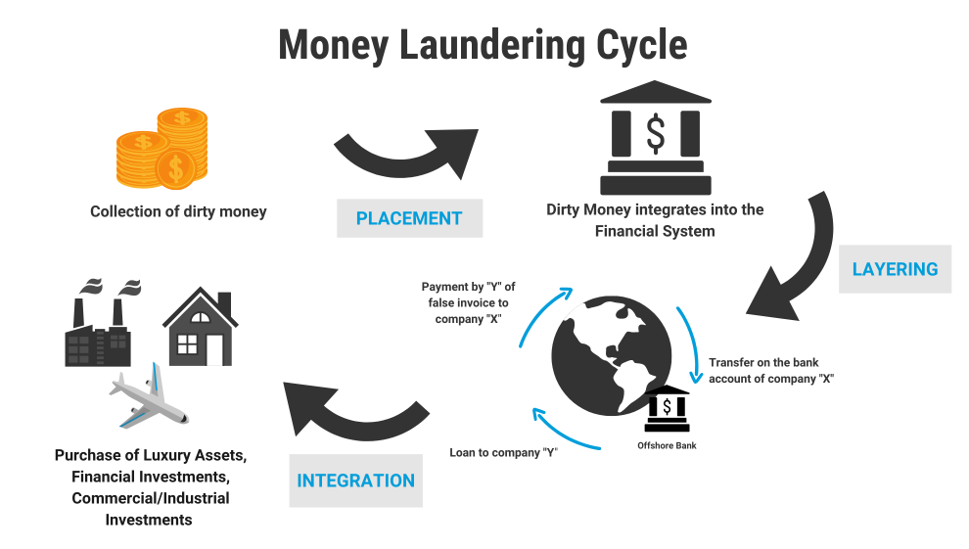
Explanation of the Problem
To begin with, money laundering is an offence in its own right — but it is also closely related to other forms of serious and organised crime as well as the financing of terrorism. In addition to organised criminal groups, professional money launderers perform money laundering services on behalf of others as their core business. The scale of money laundering is difficult to assess, but it is considered to be significant. The (UNODC) estimates that between 2 and 5% of global GDP is laundered each year.
.
The notorious act of money laundering typically takes place in three steps:
Placement (i.e. moving the funds from direct association with the crime)
Layering (i.e. disguising the trail to foil pursuit)
Integration (i.e. making the money available to the criminal from what seem to be legitimate sources)
In the initial - or placement - stage of money laundering, the launderer introduces his illegal profits into the financial system. This might be done by breaking up large amounts of cash into less conspicuous smaller sums that are then deposited directly into a bank account, or by purchasing a series of monetary instruments (cheques, money orders, etc.) that are then collected and deposited into accounts at another location. After the funds have entered the financial system, the second – or layering – stage takes place. In this phase, the launderer engages in a series of conversions or movements of the funds to distance them from their source.

Slide 18
Explanation of the Problem
The funds might be channelled through the purchase and sales of investment instruments, or the launderer might simply wire the funds through a series of accounts at various banks across the globe. This use of widely scattered accounts for laundering is especially prevalent in those jurisdictions that do not cooperate in anti-money laundering investigations. In some instances, the launderer might disguise the transfers as payments for goods or services, thus giving them a legitimate appearance.
Having successfully processed his criminal profits through the first two phases the launderer then moves them to the third stage – integration – in which the funds re-enter the legitimate economy. The launderer might choose to invest the funds into real estate, luxury assets, or business ventures.
In reality money laundering cases may not have all three stages, some stages could be combined, or several stages repeat several times. For instance, cash from the sales of common drugs is divided into small amounts then is deposited by “money mules” and afterwards transferred as payment for services to a shell company.
In this case the placement and layering are done in one stage. Whilst money laundering is used for a variety of criminal activites, most commonly drug distribution, recent devleopments in the industry have also included more serious offences such as terrorist and proliferation financing. As money laundering is a consequence of almost all profit generating crime, it can occur practically anywhere in the world. Generally, money launderers tend to seek out countries or sectors in which there is a low risk of detection due to weak or ineffective anti-money laundering programmes.

Slide 19
Explanation of the Problem
Because the objective of money laundering is to get the illegal funds back to the individual who generated them, launderers usually prefer to move funds through stable financial systems. Money laundering activity may also be concentrated geographically according to the stage the laundered funds have reached. The integrity of the banking and financial services marketplace depends heavily on the perception that it functions within a framework of high legal, professional and ethical standards. A reputation for integrity is the one of the most valuable assets of a financial institution.
If funds from criminal activity can be easily processed through a particular institution – either because its employees or directors have been bribed or because the institution turns a blind eye to the criminal nature of such funds – the institution could be drawn into active complicity with criminals and become part of the criminal network itself. Evidence of such complicity will have a damaging effect on the attitudes of other financial intermediaries and of regulatory authorities, as well as ordinary customers. As for the potential negative economic consequences of unchecked money laundering, one can cite inexplicable changes in money demand, prudential risks to bank stability, contamination effects on legal financial transactions, and increased volatility of international capital flows and exchange rates due to unanticipated cross-border asset transfers.
Also, as it rewards corruption and crime, successful money laundering damages the integrity of the entire society and undermines democracy and the rule of the law, which in turn acts as a catalyst for increasing overall crime rates in a country.

Slide 20
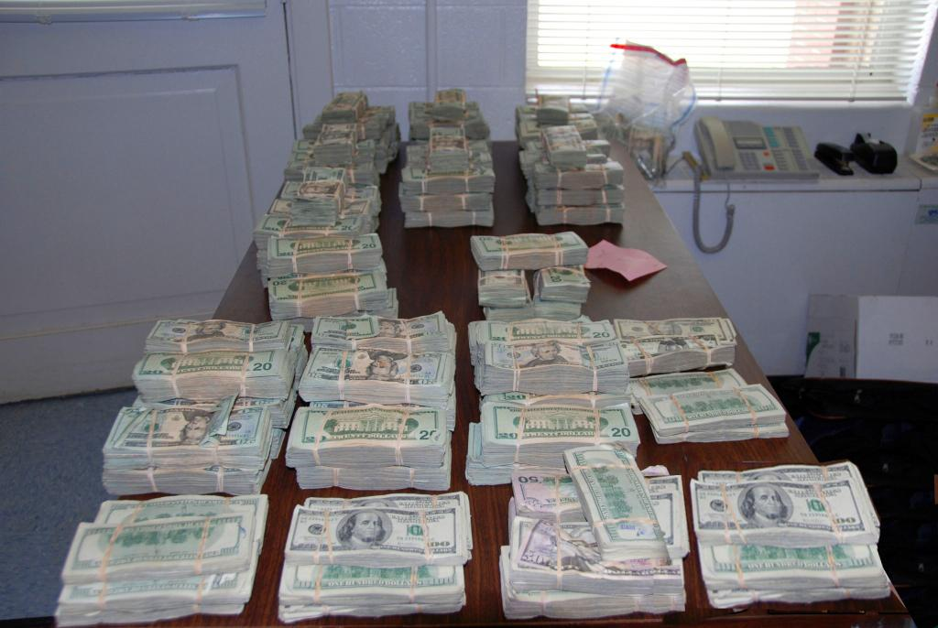
Explanation of the Problem
On the other hand, civil asset forfeiture is a legal mechanism used by law enforcement and security agencies which is accompanied by large drawbacks such as biased and one-sided trials taking place with little to no evidence supporting the party whose assets have been seized. Around the world, it has been observed that law enforcement agencies usually receive kickbacks from higher national agencies such as national justice departments and high courts. Going into more depth, it can be seen as an initiative taken by governments in good spirit but is fraught by numerous pitfalls. Around the world, there have been incidences of random searches and raids being done on individuals and companies with the intention of uncovering crimes but have only resulted in the unfair and unjust encroachment of assets.
Unexplained Wealth Orders or, UWO’s would give the state the power to seize wealth that appears to be beyond a person’s financial means, unless that person can provide an adequate explanation of where the wealth came from. UWOs would be intended to target the proceeds of crime. However, UWOs may not require the target of the order be convicted of a crime, or even be suspected of a crime. There is no evidence that civil forfeiture is effective in deterring money laundering and illegal activity, but states around the world continues to rely on it heavily. This could be because civil forfeiture enables a “tough on crime” message without adding to the provincial budget.

Slide 21
Explanation of the Problem
The Civil Forfeiture Office in Canada for example, is self-funded, meaning its budget comes from the money it seizes on an annual basis instead of tax dollars. Researchers have shown that self-funding models can create perverse incentives for public authorities to use civil forfeiture laws to benefit their bottom lines rather than to combat crime. There are a number of models for UWOs in other countries. However, they generally allow property to be seized without a criminal conviction and put the burden on the owner to prove their wealth was acquired by legitimate means. In some jurisdictions, UWOs do not require suspicion of criminal activity—the appearance of too much wealth is enough. Further, UWOs may not only apply to wealthy people. In some jurisdictions, there is no financial threshold for issuing a UWO.
The EU’s new regulations permit states to seize and confiscate assets without an underlying criminal conviction.12 This feature of the new regulations invites comparisons to the American system of civil asset forfeiture. Critics claim the U.S. system, which also allows seizure and forfeiture without a criminal conviction, incentivizes abuse and offers inadequate safeguards for property owners.
The EU regulations have some built-in, structural safeguards. Unlike the U.S. system, confiscation orders must be issued within the framework of a criminal proceeding, ensuring procedural safeguards. Thus, the determination that an asset was involved in or derived from a criminal offense is made by a disinterested court. In the U.S., law enforcement can seize property without a warrant as long as the officers have probable cause to believe the property has a nexus to criminal activity. And, in many instances, law enforcement can take ownership of seized property without a court proceeding. Quite recently, another method has been in the spotlight, this slightly different but related tool are lifestyle audits. They consist of an assessment of an individual’s income, assets, and investments to determine if they match that person’s legitimate income.

Slide 22
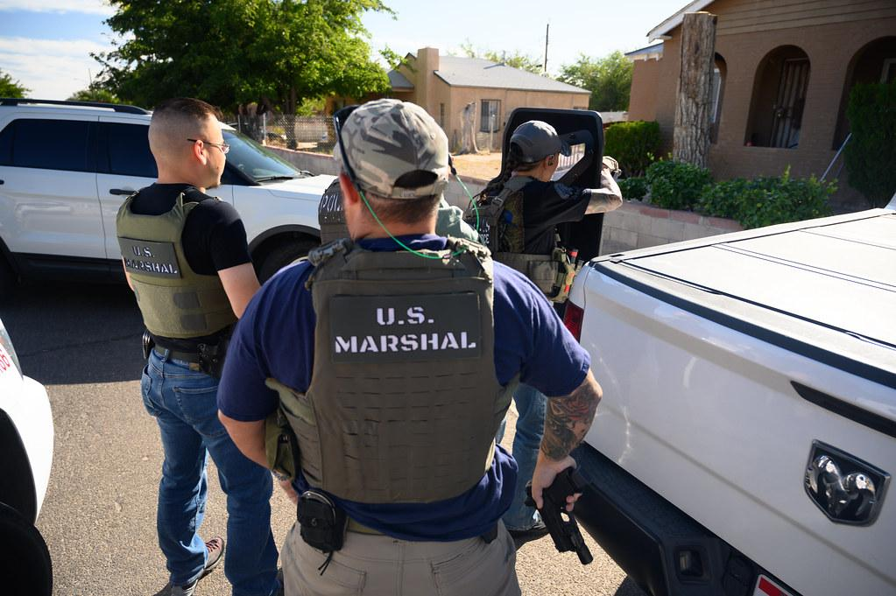
Explanation of the Problem
They are useful for determining whether the extravagant lifestyle of an individual is the consequence of illicit enrichment. Lifestyle audits can be used not only to identify indications of illicit enrichment, but also to single out specific assets that can later be targeted by confiscation.
Cash is by far the most common property type seized by local, state, and federal law enforcement agencies. Police may seize cash in the absence of drugs or other contraband, considering the cash’s very presence, even in low amounts, as evidence of a crime. In the case of the US for example, this means people without access to bank accounts—a group in which Hispanic, black, working-age disabled, lower-income, less-educated, and younger households are overrepresented—may be particularly vulnerable to forfeiture.
Not only are lower-income individuals likely at greater risk of having property seized for civil forfeiture, but they are likely to find forfeiture actions more difficult to fight. Property owners in civil forfeiture cases are not entitled to a free attorney. If they cannot afford one, they must navigate the daunting process alone.
Civil forfeiture is supposed to fight crime, but evidence is scant that it does. Evidence is more plentiful that civil forfeiture laws give law enforcement the ability and the incentive to take property from innocent people and that disadvantaged communities are disproportionately paying the price. Ironically, targeting communities in this way may make them less safe.

Slide 23
Focus of the Debate
Below listed are some examples of the aims that should be achieved during the time of debate:
- Strong emphasis on ways for member nations to effectively collaborate with entities such as the FATF, World Bank and other monetary vigilant agencies to increase levels of transparency within their domestic civil organizations.
- Deciding whether or not more able countries should have the obligation of supporting international efforts targeting individuals .
- Listing out methods by which a nation which is financially weak can be assisted in combating and reducing the occurrence of money laundering and illegal asset forfeiture
- Deciding that countries who have regularly supported causes and efforts to reduce and manage these problems from rising should be provided with stronger levels of monetary assistance by economic agencies or not.
- Closely monitoring governments who hesitate to take action against individuals/organizations operating in their countries who commit the illegal acts of money laundering and asset forfeiture and seeing as to whether those aforementioned governments should be subjected to financial penalties by the UN.
The Committee would be required to focus upon the methods to which the overall rate of assistance and support to areas of armed conflict around the world. Given that the topic mainly speaks about money laundering and asset forfeiture on a broad scale, it is highly recommended that all entities such as: individuals, companies and organizations of all types involved should be mentioned.
Reviewing the various constitutions, conventions and treaties that have been flawed with regards to the adequate rate of response to issues regarding money laundering and illegal asset forfeiture would be highly appreciated during committee sessions.

Slide 24
Questions to Consider
What efforts has your country taken to curb the issue of money laundering?
Should financially weak nations be forced to take on reducing levels of asset forfeiture on their own?
What has the UNODC done in the past to curb these issues?
How can the countries in this conference collaborate with other agencies (ie: IMF), to deal with these issues.
Has your country tried to modify it’s asset forfeiture laws?
How strong is your country financially and can it provide assistance to weaker nations?
Has your nation collaborated with agencies such as the Interpol to imprison both international fugitives?
Do national agencies in your country conduct regular audits into the flow of money within their systems ?
Has your nation increased its penalties for fugitives caught in the act of money laundering?

Slide 25
Recommended Readings & Bibliography
https://www.lexology.com/library/detail.aspx?g=1acd50be-5237-4ba8-8651-0f6e93748feb
https://www.fatf-gafi.org/faq/moneylaundering/
https://f3magazine.unicri.it/?p=1489
https://www.justice.gov/afms/about-asset-forfeiture-program-afp
https://www.youtube.com/watch?v=WRIzx8WGnpM
https://star.worldbank.org/sites/default/files/Non%20Conviction%20Based%20Asset%20Forfeiture.pdf
https://www.unodc.org/unodc/en/money-laundering/overview.html#:~:text=The%20estimated%20amount%20of%20money,goes%20through%20the%20laundering%20cycle.
https://www.europol.europa.eu/crime-areas-and-statistics/crime-areas/economic-crime/money-laundering

