Slide 1
Social, Cultural and Humanitarian
Third General Assembly - GA3

Slide 2
Table of Contents
Letter from the Chairs 3
Introduction to the Committee 4
Topic 1: Measures to protect threatened World Heritage Sites and natural areas
Introduction 6
Explanation of the Problem 9
Focus of the Debate 16
Questions to Consider 18
Recommended Readings 19
Bibliography 35
Topic 2: Indigenous communities around the world and the right to self-government
Introduction 20
Explanation of the Problem 22
Focus of the Debate 32
Questions to Consider 33
Recommended Readings 34
Bibliography 38

Slide 3
Letter from the chairs
Greetings Delegates!
Welcome to the Third General Assembly at WINMUN. We would firstly like to congratulate you for deciding to spend your time debating important issues, discussing non-specific problems as well as crucial issues faced by the world today for three continuous days.
This background guide has been designed by the dais of the Third General Assembly as a means of aiding you in your country’s research; as such, we would expect you only to use it as your basis of research from which you may feel free to branch out. We encourage you to speak as much as you can during the conference days while at the same time Keeping in mind WINMUN rules of procedure.
To perform well, we would also expect you to have adequate knowledge about your country and the solutions that you propose. Consequently, we would suggest you use a plethora of online resources such as UN websites, your official country websites and think tanks. The more you research, the more you stand out in committee!
Whether you are a first timer or an expert delegate, We hope this conference will be a great opportunity for you to broaden your horizons, make new friends and most importantly build upon your social skills. We look forward to seeing you all with the interesting debate and the loads of fun that the Third General Assembly has to offer!
If you have any doubts or if you would need any help, please feel free to contact us!
@: winmun2022.ga3@gmail.com
Regards,
Chairs of General Assembly 3

Slide 4
Introduction to the committee
Considering your role as a delegate of the Third General Assembly, its prudent that you acquaint yourselves with the committee:
SOCHUM is one of the main GA committees; therefore, like the other main committees of the GA, it was established in 1947. And it follows the rules of the General Assembly, which is indicated in the Charter of the United Nations.
SOCHUM is a forum for UN Member States to discuss social, humanitarian, and cultural issues, especially those related to human rights. The SOCHUM and its subsidiary body, the Economic and Social Council (ECOSOC), take the lead in drafting general resolutions on these matters.Unlike Security Council resolutions, resolutions passed within the context of a General Assembly are not binding, SOCHUM serves as no exception. Resolutions, by in large, are a set of recommendations for the member states to ratify and adjust accordingly.

Slide 5
Introduction to the committee
In our humble opinion, matters relating to social, humanitarian or cultural issues are more difficult to solve in comparison to dilemmas pertaining to economic, financial or security. Culture, and social structure is often difficult and costly to change, because they are the factors which make a “community’’, or a ‘’nation’’ unique and special. They are the web which connect nations and people to one another.
That being said, a delegate must come up with a set of practical ideas and consider humanitarian facts while trying keeping in mind the ethics and cultural norms of all parties the resolution is pertaining to. Truly all encompassing ideas must address all three facets of the committee, which are the aforementioned social, humanitarian and Cultural
As you learn more, We are confident that you will be able to come up with realistic ideas that respect and takes into consideration the cultural, religious, social rights and the thousands of different lifestyles embraced by people all over the world.Moreover, upon the selection of the topic, the committee must be able to draft a resolution which must attain a two-thirds majority to pass.

Slide 6
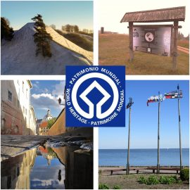
Committee: The United Nations General Assembly Three
Topic: Measures to protect threatened World Heritage Sites and natural areas
Authors: Aaditya Gandhi and Sabira Raisa
Introduction
The ice Mount Kilimanjaro in Tanzania, the living museum of the evolution of the Galapagos islands in Ecuador or the iconic barrier reef in Australia are only 3 of over 250 natural sites inscribed on UNESCO’s world heritage list in more than 95 countries. Natural world heritage harbour unique and endangered species, spanning over 3.5 million square kilometres, the site protects some of earth's most significant natural assets and vital biodiversity; they are of outstanding universal value to humanity.
Two – thirds of the natural world heritage site are crucial sources of water and half are essential to prevent disasters such as floods and landslides, they play a key role in climate regulation and carbon sequestration essential in fighting global warming, they also boost socioeconomic development.

Slide 7
Introduction
The sites inscribed in UNESCO’s world heritage list are protected under the world heritage convention established in 1972; thanks to this unique intergovernmental treaty UNESCO can bring together the world’s nation and people to harness the protection of humanity’s most exceptional cultural and natural heritage but UNESCO world heritage sites face serious threats such as climate change, invasive species, unsustainable tourism, poaching, mining, infrastructure and economic projects. SOCHUM may work together to address these to safeguard our planet’s future for generations to come; for example, to tackle the increasing number of emergencies that not only natural but also cultural heritage sites are experiencing. UNESCO aids through the rapid response facility; the world’s fastest conservation fund. The Belize barrier reef reserve has been threatened by offshore oil exploration and coastal development, thanks to international cooperation under the world heritage convention oil exploitation has been banned and the site has been removed from the world heritage in danger benefiting around two hundred thousand Belizeans who depend on the reef for their livelihood.

Slide 8
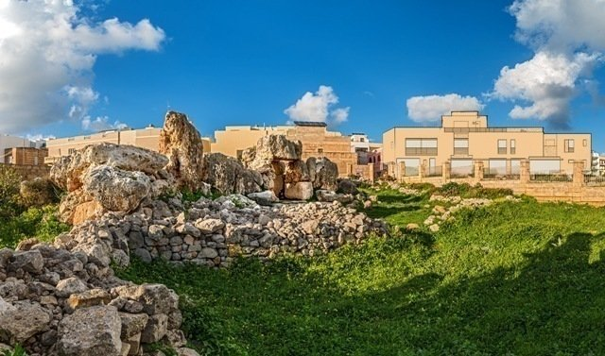
Introduction
Cultural heritage is a foundation for understanding who we are, it's a vibrant part of our present and future but around the world cultural sites are under threat; war, climate change, neglect, overtourism, and irresponsible development all pose growing challenges to conserving cultural heritage. It is to be believed that cultural heritage is more than history. Preserving our cultural heritage promotes stability and peace and leveraging cultural sites creates a substantial financial asset. In 19 countries, at 28 sites and with 120 partners, the global heritage fund connects people to their heritage. These measures represent the ongoing importance of the world heritage convention for a global conservation effort and advancing the endeavour to protect shared heritage over generations and support sustainable development essential for humanity’s future on this planet.

Slide 9
Explanation of the Problem – Defining Key Terms
The foci of the debate at hand are both subject to a multitude of threats to their continuing existence that urgently demand protection. However, to best address these issues, it is vital to first clearly define ‘World Heritage sites’ and ‘natural areas’ in the context of the mandate before reviewing the terms and relative success of past conventions.
‘World Heritage sites’ have a clear cut definition. Per UNESCO's 1972 World Heritage Convention, landscapes and sites of outstanding universal value can be designated World Heritage Sites. As of June 2022, these sites, which are collectively grouped within the World Heritage List, number at 1154 properties. The 1972 Convention clearly defines the parameters that any given cultural or natural site must meet to qualify for selection by the World Heritage Committee, which is responsible for the agreement’s implementation. It is worth noting that these parameters are not set in stone, and that there is room for change, as occurred in 1994 following the launch of the Global Strategy for a Representative, Balanced and Credible World Heritage List. Although the Convention itself is fixed, the ‘Operational Guidelines for the Implementation of the World Heritage Convention’ are open to change, enabling constant improvement. As such, the World Heritage Committee has the ability to recognise flaws in selection for World Heritage Sites and address these concerns by altering identification and approval processes.

Slide 10
Explanation of the Problem – Defining Key Terms
Per current mechanisms outlined by UNESCO, states are encouraged to submit tentative lists, which are inventories 'of those properties which each State Party intends to consider for nomination'. UNESCO suggests these lists be multilaterally devised within the country, with the support of a number of stakeholders, ranging from local communities and NGOs to governments at regional and state levels. Should states choose to then formally nominate their properties for ascension to the World Heritage List, they must then present a nomination file (created with support from the World Heritage Centre). Two Advisory Bodies mandated by the World Heritage Convention – the International Council on Monuments and Sites (ICOMOS) and the International Union for Conservation of Nature (IUCN) – must then evaluate the nominated sites. The final decision is left to the intergovernmental World Heritage Committee, which convenes once a year. The Committee must agree that the chosen sites must meet at least one out of ten selection criteria (explained in the Operational Guidelines) for the site to finally join the World Heritage List. Although the process is robust, the participation of member states is crucial. If a state does not include a site of accepted cultural importance on its Tentative List to begin with, then the World Heritage Committee cannot consider any nomination for its inscription. Unfortunately, not all countries have submitted these Tentative Lists yet. Furthermore, there remain latent gaps in the selection of sites on a state level.

Slide 11
Explanation of the Problem – Defining Key Terms
However, all World Heritage sites are bound to experience a certain element of risk, some more than others. To an extent, the World Heritage Convention acknowledged this as fact, and per Article 11(4) established the 'List of World Heritage in Danger'. As of June 2022, 52 such properties have been identified, and the List not only identifies these properties but also specifies the given threats experienced and the cost of any requested conservation operations. Although the List is a powerful informative tool meant to encourage corrective action that also highlights the key threats experienced by properties, measures must be taken to further elaborate on precise corrective action. Furthermore, the List is limited in scope in that it attends to threats requiring immediate assistance: longer-term 'creeping' threats are not afforded as much recognition. As such, prevention of these risks from manifesting to begin with is not supported by the List. It is also important to note the varied perceptions of the List – whilst some countries welcome inscription of a site as a means of focussing international attention on the issue, others see it as a mark of dishonour. This de facto view of the List as a shameful ‘sanction’ thus hinders its efficacy.
When approaching the agenda, a clear understanding of the key topics at hand is key. Although mechanisms for the identification of threatened sites do exist (primarily in the form of the aforementioned List), the debate must also take into account other sources (for instance, NGOs), and work towards creating an eventual resolution that comprehensively covers all World Heritage sites that may be deemed as ‘threatened’

Slide 12
Explanation of the Problem – Threats Faced
The exact nature of the threats World Heritage Sites may experience varies greatly, and may also depend on whether it is a cultural or natural property. Transparent mechanisms must be presented that take into account the relative magnitude of these threats and the urgency they demand as part of an international response.
The most common threats to Natural World Heritage Sites are invasive non-native species, unsustainable tourism, poaching, hydroelectric dams, and logging, with climate change the fastest growing threat.
More than a third of United Nations World Heritages sites with natural Outstanding Universal Value are under threat, according to a recent report by the IUCN, the International Union for Conservation of Nature. The first assessment of all 241 natural World Heritage sites globally found that 29 percent are of “significant conservation concern,” while a further 7 percent are worse off, with “critical concerns.”
Famous heritage sites evaluated to be at risk include Indonesia’s Komodo National Park, Ecuador’s Galapagos Islands, Australia’s Great Barrier Reef, and Peru’s Machu Picchu. The report found tropical sites to be among the most critically threatened, especially in Africa, where developing nations often lack the funds to properly protect the preserves.
Replicating the successful strategies of World Heritage Sites like these may help improve the outlook of over 200 sites of concern. “We need to scale up and echo these solutions elsewhere,” concludes Shadie. Poor management and a lack of law enforcement and government involvement are frequently listed as key threats – all challenging problems to remedy in developing nations.
The protection of ‘World Heritage’ by international convention was preceded by the safeguarding campaigns of Abu Simbel (Egypt), the Borobodur Temple Compounds (Indonesia), and Venice and its Lagoon (Italy) in the 1960s.

Slide 13
Explanation of the Problem – Threats Faced
The vulnerability of these sites to threats like pillaging, erosion, and construction, coupled with the power and success of international campaigns for their preservation, led to a convention to protect ‘common cultural heritage of humanity.’
The United Nations committee regularly places sites marred by mismanagement, climate change, and other impacts on its “World Heritage in Danger” list before delisting them completely. In 2021, Australia’s Great Barrier Reef narrowly avoided a downgrade and now had until February 2022 to produce a progress report on its health. Meanwhile, Liverpool, England, was officially stripped of its UNESCO designation after several warnings about detrimental new construction along its historic waterfront.
The good news? The looming threat of losing this ​​privileged recognition is a major wake-up call for existing UNESCO World Heritage sites, including those not in immediate danger. As a result, more locations are rolling out updates that will change how travelers interact with cultural and natural heritage, and will, hopefully, increase the resiliency of these sites in the face of growing environmental impacts and overtourism.
“Countries are increasingly signing onto sustainable development models where cultural heritage conservation plays a role,” says Susan Macdonald, head of Getty Conservation Institute Field Projects, which recently hosted an in-depth discussion with cultural heritage leaders about the pandemic’s impact on conservation efforts. “In other places, the lure of development makes it hard to achieve well-balanced approaches—this takes commitment, leadership, and long-term vision.”

Slide 14
Explanation of the Problem – Past Action
Several past conventions have been implemented with relevance to the agenda, and there exist bodies working to protect all manner of heritage, within which threatened World Heritage Sites also fall. However, their relative success in the contemporary world must be evaluated to best identify ways in which these actions could be expanded upon, and also to deal with the apathy certain states display when it comes to abiding by the regulations of ratified conventions.
Naturally, the World Heritage Convention is of much relevance here, having instituted the mechanism for the World Heritage List to begin with. While it has been detailed earlier, it would be prudent to further look into its terms and efficacy.

Slide 15
Explanation of the Problem – Past Action
The United Nations Educational, Scientific and Cultural Organization – better known as UNESCO – is a key player here, having been founded with the express aim of encouraging cultural exchange and preservation following the disastrous pillaging of such sites during WWII. Its World Heritage Centre strives to achieve a broad set of goals in relation to the 1972 World Heritage Convention, and it thus serves as a unique focal point for protection efforts. The role of UNESCO and its World Heritage Centre should be noted and enhanced to most effectively address the agenda.

Slide 16
Explanation of the Problem – Past Action
It is also worth considering the role of the Advisory Bodies mandated by the World Heritage Convention. In addition to the previously mentioned ICOMOS and the IUCN, there also exists the International Centre for the Study of the Preservation and Restoration of Cultural Property (ICCROM), which provides the World Heritage Committee 'with expert advice on conservation of cultural sites, as well as on training activities'. ICCROM’s mission is to provide member states with the best tools and knowledge to preserve their cultural heritage in all its forms by cooperation with several institutions and professionals locally and internationally. To this end, it studies and promotes heritage conservation, mobilises expertise to address pertinent issues, and provides any training necessary for implementation. As a notable intergovernmental organisation directly connected to the issue of conservation, it is sure to play an important role in addressing the agenda of the committee.

Slide 17
Explanation of the Problem – Past Action
The 1954 Hague Convention for the Protection of Cultural Property in the Event of Armed Conflict is also worth a mention. It committed to the protection of heritage properties in both peacetime and wartime, thus marking a turning point in the protection of such sites – given the devastating effect of armed conflict on the stability of these properties. The Convention introduced a number of obligations to ensure its aim of protecting all cultural property, regardless of origin or ownership. These include the adoption of preventive measures such as the preparation of inventories, the provision of locations for eventual refuge to shelter movable cultural property, the establishment of special units within military forces responsible for the protection of cultural property, and more. In emphasising the importance of cultural heritage and prioritising it over conflict, the acceptance of the 1954 Hague Convention was indeed a watershed moment in addressing the agenda at hand.

Slide 18
Explanation of the Problem – Past Action
Blue Shield International is an independent, international NGO that works in part to support the 1954 Convention by protecting heritage during armed conflicts and disasters around the world. It was founded in 1996 by the four major international cultural heritage organisations: the International Council on Archives (ICA), the International Council on Museums (ICOM), the International Council on Monuments and Sites (ICOMOS) and the International Federation of Library and Information Associations and Institutions (IFLA). BSI has 29 national committees operating across the world, with more to follow and as an advisory body to UNESCO should be supported when ideating measures to support the agenda.

Slide 19
Focus of the Debate
Much of the debate can be expected to centre around how best to deal with threats to World Heritage Sites, and the extent to which the international community should be expected to take on an involved role collectively. Such discussion must be done within the context of past actions as well as existing legislation surrounding World Heritage Sites.
For instance, countries shall have to determine whether they by and large support prevention or mitigation.
Those supporting a preventative approach are likely to encourage a robust preparedness mechanism and call for greater state/UN involvement when it comes to locations designated as World Heritage Sites. This would include special measures to ensure the protection of Sites at risk of grave potential threat in the case of armed conflict or other such factors – indeed, this has already been enacted to some degree, as seen through the limited 'Enhanced Protection' mechanism established by the 1999 Second Protocol to the 1954 Hague Convention for the Protection of Cultural Property in the Event of Armed Conflict. By drawing on such precedent, a case for this camp would certainly be strong. However, state parties supporting such policies would have to answer to questions regarding the funding of such projects, whether from existing UN sources (provided they can afford such a cost) or through outlining the creation of new sources for funds. Access to such funding – whether universal or only given to countries that cannot afford it themselves – would also be brought into question. Some countries may also oppose preventative measures by decrying them as being far too invasive, supported by Article 6 of the World Heritage Convention which acknowledges that the sovereignty of the state where a property is located must not be compromised.

Slide 20
Focus of the Debate
Those supporting mitigating measures would either be in favour of the status quo or be appealing for a rollback of extant legislation surrounding the protection of threatened World Heritage Sites. Although likely to be more cost-effective and thus well within the present means of organisations such BSI and the World Heritage Fund that must finance such measures, these supporters would also have to prove that any legislation presented is capable of coping with all possible threats and fully supports the resolution of the agenda at hand. Such an approach would all but guarantee damage to properties, so compensatory measures or evidence of rapid response is a given for those opting for such an approach.
Another focus is sure to be the question of those Heritage Sites that have already been damaged in some way. Discussion is to be expected as to whether or not these sites have any hope of rehabilitation, and if so, which measures are suitable. This must then be future-proofed so as to be compatible with the restoration of any future Sites as well.
The debate can also be expected to focus on the willingness or ability of state parties to take measures to support threatened World Heritage Sites. Often these Sites offer valuable economic stimulus in the form of tourism – in such a case, despite the damage such activity may do to the location, the role of the site in supporting the economy must be dealt with. Additionally, some countries may not be in a position to support the protection of threatened sites to the extent to which proposed Resolutions demand – the debate must answer these worries as well.

Slide 21
Questions to Consider
How could countries promote their World Heritage Sites, but also protect them from the dangers of tourism?
Should states be punished for failing to protect threatened World Heritage Sites? Do repeat offenses warrant greater punishment, if any?
Article 6 of UNESCO's 1972 World Heritage Convention suggests that the protection of world heritage sites is a shared responsibility of the international community – to what extent does this hold? In other words, is it the responsibility of nations to protect the heritage of another country?
Article 6 also declares that the sovereignty of the state where the property is located should not be compromised in ensuring the property’s protection. What might count as a nation’s sovereignty being compromised? Should the World Heritage Committee Operational Guidelines be relaxed in this regard?
The 'Enhanced Protection' mechanism established by the 1999 Second Protocol to the 1954 Hague Convention for the Protection of Cultural Property in the Event of Armed Conflict as of March 2019 grants 12 properties access to military protection should conflict break out, albeit with strict eligibility criteria. Should these criteria be relaxed, or similar legislation be modelled, justifying military action to protection World Heritage Sites? In which types of conflicts might this be permissible – terrorist action, civil war, invasion?
How might possible solutions be made transparent and accessible to support member states and civil society?
What role does the public play in protecting threatened World Heritage Sites? Should efforts be made to increase public interest and awareness?

Slide 22
Recommended Readings
https://whc.unesco.org/en/convention/
https://whc.unesco.org/en/danger/
https://www.awe.gov.au/parks-heritage/heritage/about/world/management-australias-world-heritage-listed/managing-world-heritage-australia/conserving-world-heritage
https://www.un.org/press/en/2016/sgsm17664.doc.htm

Slide 23
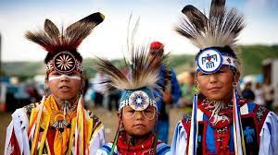
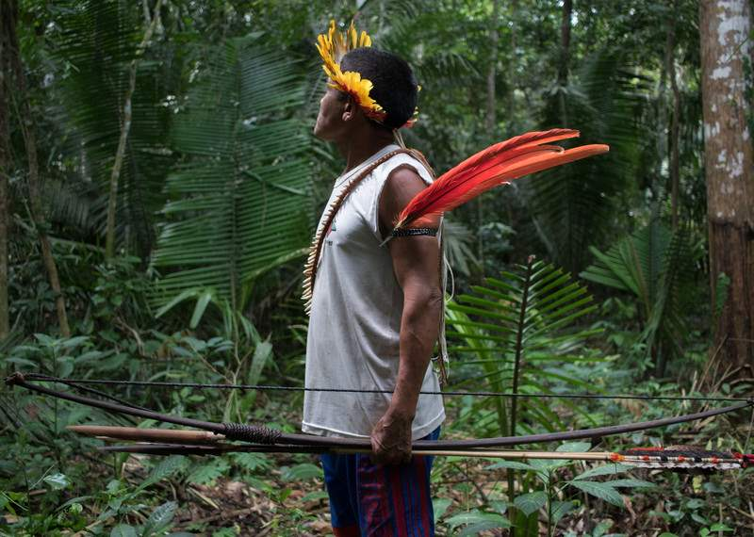
Committee: The United Nations General Assembly Three
Topic: Indigenous communities around the world and the right to self-government
Author: Ameer Sarfarazhusain
Introduction
Indigenous peoples all around the world are usually known by their distinct way of life and systems based on ancient land connections and norms.
They own, occupy or protect 80% of the world’s biodiversity, even though they only reside in 25% of the world’s surface area. They have invaluable ancestral information and skills on how to adapt to, mitigate, and lessen the dangers of climate change and disasters.

Slide 24
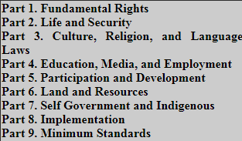
Introduction
Although they carry such importance to us, they are still discriminated against and prevented from accessing basic and broader rights.
Firstly, They don’t receive even the most basic human rights, as promised in the Universal Declaration of Human rights, due to discrimination by states or others in the territory they may reside in. This is further exacerbated when. secondly, they are promised rights that include special rights for indigenous populations such as being educated in their own language or having access to their own media; which should be provided by the state, as stated in the United Nations Declaration of the rights (UNDRIP) of indigenous people.
Lastly, but most importantly, within these special rights they are also promised the right to self determination and the right to self-government.
Divisions of the rights as enshrined in the UNDRIP @University of Minnesota

Slide 25
Explanation of the problem
-Defining Key Terms
To start off, an indigenous person would be defined by the United Nations Special Rapporteur to the Sub-Commission on Prevention of Discrimination and Protection of Minorities, Indigenous communities, peoples and nations are:-
…those which having a historical continuity with pre-invasion and pre-colonial societies that developed on their territories, consider themselves distinct from other sectors of societies now prevailing in those territories, or parts of them. They form at present non-dominant sectors of society and are determined to preserve, develop, and transmit to future generations their ancestral territories, and their ethnic identity, as the basis of their continued existence as peoples, in accordance with their own cultural patterns, social institutions and legal systems. (Martinez-Cobo, 1984)
To add on, they can also be identified by certain characteristics such as:
Most importantly, they self-identify as Indigenous peoples
There is a historical link with those who inhabited a country or region at the time when people of different cultures or ethnic origins arrived
They have a strong link to territories and surrounding natural resources
They have distinct social, economic or political systems
They have a distinct language, culture and beliefs
(source:Amnesty international)

Slide 26
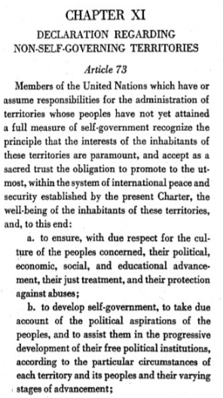
Explanation of the problem
-Defining Key Terms
Essentially, self-government refers to “the control of a country or an area by the people living there, or the control of an organization by a group of people independent of central or local government:” (cambridge dictionary)...
This is exclaimed in the UN charter Article 73(b):
Although, the chapter in the UN charter was for non-self-governing territories (in context to decolonization). If a certain group of people is consistently denied the ability to participate in the government of the state, or if individuals within that group are subjected to systematic and grave human rights abuses that make participation in the state impossible. On a practical view, this means that the group may fall under the category of non-self-governing; as it is governed not by its will or voice.

Slide 27
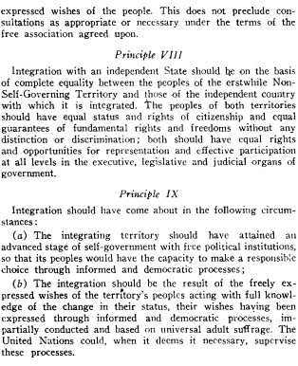
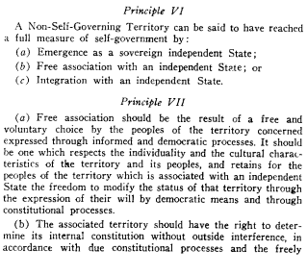
Explanation of the problem
-Defining Key Terms
Due to the vague nature of Article 73c (view previous slide), the general assembly released a resolution:1541 (XV). where it layed down certain principles:
https://documents-dds-ny.un.org/doc/RESOLUTION/GEN/NR0/153/15/PDF/NR015315.pdf?OpenElement

Slide 28
Explanation of the problems- Defining Key Terms
Self-Governance is only provisioned for, due to the people’s right to “Self Determination“
Self Determination denotes the legal right of people to decide their own destiny in the international order
Contemporary notions of self-determination usually distinguish between “internal” and “external” self-determination, suggesting that "self-determination" exists on a spectrum. Internal self-determination may refer to various political and social rights; by contrast, external self-determination refers to full legal independence/secession for the given 'people' from the larger politico-legal state.” (Cornell Law School)
In this case, recognizing the right to Self Determination is the causation of the right to self- government. Allowing for internal self determination could just mean allowing indigenous populations the right to vote(and other socio-political rights within a country), but on the other hand external self- determination could refer to literally forming a new sovereign state independent from the country.

Slide 29
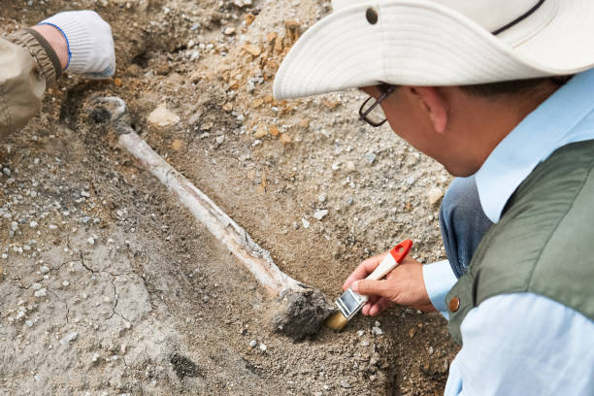
Explanation of the problem - Threats Faced
“Self” Governance
The question of when individuals may be deemed migrants arises when archaeologists and other academics unearth the immense history of human movement in and across the Pacific.
The term "indigenous" refers to something that is native to a given place. The rights of people of mixed ancestry have been a cause of heated, sometimes unpleasant discussion in a number of countries.
For example, Guam and New Caledonia have indigenous populations of little over 37 percent in Guam and 40 percent in New Caledonia, respectively. As a result, it's hardly unexpected that the question of who should be entitled to vote on self-determination has sparked significant and lengthy public debate in both territories (Maclellan 2006 ). People who can trace their Guam heritage back to 1950 - primarily indigenous Chamorros - appear to be the answer (Guampedia 2014).
In this context, not recognizing who qualifies to be of indigenous origins can lead to a major problem in deciding whether or not they deserve a say (vote) in the decisions regarding self-governance of indigenous people.

Slide 30
Explanation of the problem - Threats Faced
Internal Self Determination
Internal self-determination would refer to ensuring the civil and political rights (among all others) within a state; rather than having an independent state for indigenous peoples… Although this comes with a variety of issues. Firstly, many may not want to give them the political rights (although it has been enrishened in the UNDRIP (article 13(2), refer UNDRIP)
For example American Samoa is a 'unorganized and unincorporated territory,' which appears to mean that the United States Congress has not enacted a specific Organic Law for the territory, which is not an integral part of the United States with the benefits that come with statehood (McCormick 1993a: 654, n.1 .). Guam is classified as a 'unorganized territory,' meaning it lacks the benefits of statehood (McCormick 1993b: 657). While the indigenous people of Guam's concerns remain critical public problems, many American Samoans' preference for integration with the United States implies a common readiness to forego a separate identity for the sake of the advantages.The unwillingness of the elected representatives of the existing 50 states of the United States to agree to equal representation in Congress, particularly the Senate, is a significant issue (where every state, irrespective of size, is represented by two Senators).
This essentially limits the idea that indigenous communities would be willingly represented in the lawmaking process, considering that they decide to remain integrated within a state.

Slide 31
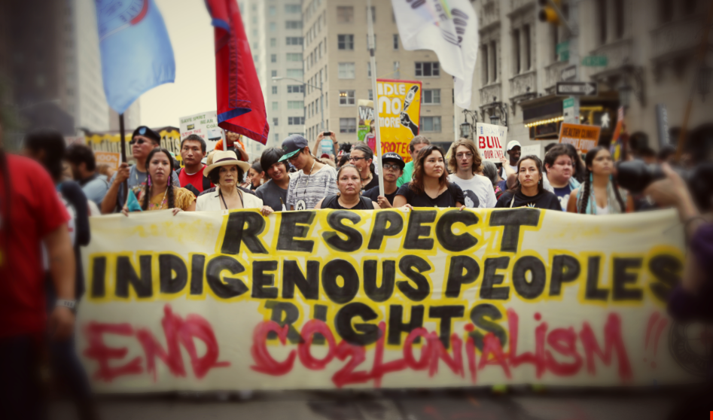
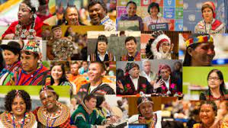
Explanation of the problem - Threats Faced
Internal Self Determination
Secondly, If indigenous populations are integrated into the state then they may face issues regarding discrimination and the threat to loss of traditions and land at large.
Many of these issues include, Lesser life chances (Dire conditions including relatively worse socio-economic conditions and poverty); Security (such as violence and criminalization due to racism); Education (inadequate resources provided by the state to deliver education in their language); Passage of culture (the loss of their ways of life only to integrate into the majorities way of life); Media (they may not have their own ways of media); no representation in decision making processes if its an integrated state and many more

Slide 32
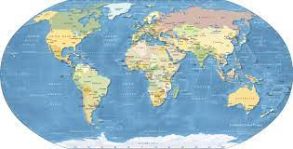
Explanation of the problem - Threats Faced
External Self determination
External Self-determination would refer to the establishment of a completely sovereign and independent state of, for and by the indigenous people.
In the shape of "Empire of Uniformity," a major legal phenomena was captured (Tully, 1995, 2000). It indicates that current constitutions are written in such a way that cultural diversity is eroded through exclusion or assimilation.In this scenario many indigenous populations would look to gain individual statehood,
However, Majority response on the question of right to secession in international politics is dismissive in nature, best exemplified the statement of the then Secretary-General of the United Nations, Mr. U. Thant (1970), “the United Nations has never accepted and does not accept and I do not believe, it will ever accept a principle of secession of a part of a Member State”.
Although the context of such is unclear and not defined as well as is outdated, thus, the General Assembly could release specific guidelines and reasons for a group of indigenous people to exercise their right to self determination and self-determinants which could allow opportunities for them towards independent statehood.

Slide 33
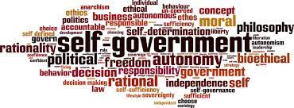
Explanation of the problem- Threats Faced
Barriers to Self-government
Even Though many indigenous communities would be willing to self-govern they may not be able to do so
In general While indigenous peoples’ right to govern themselves is well established, they face limited financial and human resources, and lack control over efforts to ensure their governance systems align with international human rights standards. (Special Rapporteur on the Rights of Indigenous Peoples)
The process much often depends not only on the sense of self and the determination with which non-self-governing territories are decolonized and then proceed to govern themselves but on the power, resources and will of their former colonial rulers, including the support they are able and willing to provide following formal decolonization.
It would normally be the state’s responsibility to help them achieve their right to self-governance by providing these resources. Although, this may be rather the opposite case if they are being oppressed by the government of the state they would want to separate from. In this case resources and recognition of the people would need a lot more assistance from the international community.

Slide 34
Explanation of problem- Past action
Self-governance initially gained momentum as a reason to decolonize territories due to the right to self determination for non-self-governing territories. The Trusteeship Council was established as one of the six United Nations' main organs. Its mission was to oversee and facilitate the transition to independence and self-governance of the Axis Powers' colonies from World War II, as well as the League of Nations' designated areas. The Trusteeship Council has finished its mandate, but it continues to exist on paper under Chapter XII of the United Nations Charter. Considered to be dysfunctional.
However, as decolonization advanced, the Charter's ambiguous "principle" of self-determination became a "right" to self-determination. These rights were further applied to indigenous peoples in accordance to General Assembly resolution 1541 (XV).
The United Nations General Assembly had declared that indigenous peoples have the right to self-determination and, as a result, the right to freely select their political status and pursue their economic, social, and cultural development by the passage of the United Nations Declaration of the Rights of Indigenous Peoples(2007)
.The Declaration's article 3 is similar to the International Covenant on Civil and Political Rights (1966) and the International Covenant on Economic, Social, and Cultural Rights'(1966) shared article 1.

Slide 35
Focus of Debate
The focus of debate could revolve around a variety of things in relation to the right to self government for indigenous peoples.
Firstly, deciding who constitutes as an indigenous person and what features they possess or what links they have would only show whether they can have a say in self-governance or not. In the modern age, the boundaries for purely indigenous may or may not be a bit relaxed based on territory, for e.g. mixed indigenous people.
Secondly, while states have a responsibility according to the UNDRIP to provide for an array for facilities such as specific language education, media, protection of culture and much more only for indigenous populations, they may argue the about the extent to which these guidelines need to be followed due to economic reasons.
Thirdly, States may not choose to allow the right to self-government to indigenous populations for various reasons, such as: population distribution, wherein they may reside on a majority of a countries land that could be disputed or the country may be unwilling to concede; loss of natural and economical benefits from the reason; loss of potential workers; and many more
Lastly, if a state is not on good terms with the indigenous population residing within, it would make it highly unlikely for them to support them, as such, could the UN play a bigger role or would that be a violation of a country's sovereignty?
The right to self-government is broad political right that can be debatably considered achievable/compromisable/of high regard, or not, based on a variety of different situations and different beliefs of states all around the world. Which is why, eventhough, debate in committee would have to be representable of one’s foriegn policy. delegate’s may also have to compromise and come to a negotiable solution if they want to solve the agenda at hand.

Slide 36
Questions to Consider
What procedures can be used to confirm a person's indigenous roots in allowing them special rights to participate in self-governance?
How could Indigenous representation be increased within social institutions and especially law-making bodies for equitable participation in society?
In what ways can discrimanation against indigenous people be mitigated?
How can indigenous cultures, traditions and ways of life be preserved by states if indigenous people are integrated into the majority culture?
How much authority should the state have if indigenous communities exercise free association and have a constitution within a state? And in what circumstances would this jurisdiction not be considered a violation of their rights?
How can states increase life chances for indigenous cultures?
In what ways can states help indigenous communities exercise their right to self-government?
Are there any specific areas that may need the UN’s attention to help recognize their right to self-government?

Slide 37
Recommended Readings
https://www.un.org/development/desa/indigenouspeoples/wp-content/uploads/sites/19/2018/11/UNDRIP_E_web.pdf
https://www.un.org/dppa/decolonization/sites/www.un.org.dppa.decolonization/files/2014_6_dp_edward_paul_wolfers.pdf
https://pesd.princeton.edu/node/511

Slide 38
Bibliography - Topic 1
Centre, UNESCO World Heritage. “World Heritage.” UNESCO World Heritage Centre, https://whc.unesco.org/en/about/
Centre, UNESCO World Heritage. “The World Heritage Committee.” UNESCO World Heritage Centre, https://whc.unesco.org/en/committee/.
Centre, UNESCO World Heritage. “What Is World Heritage? - Frequently Asked Questions (FAQ).” UNESCO World Heritage Centre, https://whc.unesco.org/en/faq/19.
Centre, UNESCO World Heritage. “World Heritage List.” UNESCO World Heritage Centre, https://whc.unesco.org/pg.cfm?cid=31&l=en&&mode=table&order=region.
Centre, UNESCO World Heritage. “Convention Concerning the Protection of the World Cultural and Natural Heritage.” UNESCO World Heritage Centre, https://whc.unesco.org/en/conventiontext/.
Centre, UNESCO World Heritage. “List of World Heritage in Danger.” UNESCO World Heritage Centre - List of World Heritage in Danger, https://whc.unesco.org/en/danger/.
Centre, UNESCO World Heritage. “World Heritage in Danger.” UNESCO World Heritage Centre, https://whc.unesco.org/en/158/.
Centre, UNESCO World Heritage. “Natural World Heritage.” World Heritage Centre, https://whc.unesco.org/en/natural-world-heritage/.

Slide 39
Bibliography - Topic 1
Centre, UNESCO World Heritage. UNESCO World Heritage Centre - Document, https://whc.unesco.org/en/documents/.
Becker, Dr. Jeffrey A., and Dr. Jeffrey A. Becker. “Organizations and Agencies That Work to Protect Cultural Heritage.” Smarthistory, https://smarthistory.org/preserve-cultural-heritage/.
Centre, UNESCO World Heritage. “Frequently Asked Questions (FAQ).” UNESCO World Heritage Centre, https://whc.unesco.org/en/faq/.
“1954 Hague Convention: United Nations Educational, Scientific and Cultural Organization.” 1954 Hague Convention | United Nations Educational, Scientific and Cultural Organization, https://web.archive.org/web/20220307191814/www.unesco.org/new/en/culture/themes/armed-conflict-and-heritage/convention-and-protocols/1954-hague-convention/.
“Enhanced Protection: United Nations Educational, Scientific and Cultural Organization.” Enhanced Protection | United Nations Educational, Scientific and Cultural Organization, https://web.archive.org/web/20190328133204/www.unesco.org/new/en/culture/themes/armed-conflict-and-heritage/protection/enhanced-protection/.
“Blue Shield.” Blue Shield | International Council on Archives, www.ica.org/en/blue-shield.
“Conserving World Heritage.” Conserving World Heritage - DAWE, www.awe.gov.au/parks-heritage/heritage/about/world/management-australias-world-heritage-listed/managing-world-heritage-australia/conserving-world-heritage.

Slide 40
Bibliography - Topic 1
“Illegal Activities Threaten Natural World Heritage, Pushing the Vaquita to the Brink and Depleting Forests.” IUCN, 3 July 2017, www.iucn.org/news/iucn-41whc/201706/illegal-activities-threaten-natural-world-heritage-pushing-vaquita-brink-and-depleting-forests-%E2%80%93-iucn.
Protecting Our World Heritage - Finance Initiative. www.unepfi.org/psi/wp-content/uploads/2018/06/Protecting-our-world-heritage.pdf.

Slide 41
Bibliography - Topic 2
“United Nations Declaration on the Rights of Indigenous Peoples for Indigenous Peoples.” United Nations, United Nations, www.un.org/development/desa/indigenouspeoples/declaration-on-the-rights-of-indigenous-peoples.html.
United Nations Declaration on the Rights of Indigenous Peoples. www.un.org/development/desa/indigenouspeoples/wp-content/uploads/sites/19/2018/11/UNDRIP_E_web.pdf.
“Indigenous Peoples.” World Bank, www.worldbank.org/en/topic/indigenouspeoples
“Indigenous Peoples.” Amnesty International, 13 Dec. 2021, www.amnesty.org/en/what-we-do/indigenous-peoples/#:~:text=They%20have%20distinct%20social%2C%20economic,and%20systems%20as%20distinct%20peoples.
“Self-Government.” Cambridge Dictionary, https://dictionary.cambridge.org/dictionary/english/self-government.
“Self Determination (International Law).” Legal Information Institute, Legal Information Institute, www.law.cornell.edu/wex/self_determination_(international_law).

Slide 42
Bibliography - Topic 2
“Indigenous Sovereignty” and Right to Self ... - Sage Journals. https://journals.sagepub.com/doi/full/10.1177/1177180121994681.
The Rights of Indigenous Peoples, http://hrlibrary.umn.edu/edumat/studyguides/indigenous.html
International Covenant on Economic, Social and Cultural Rights, G.A. Res.2200A (XXI), 21 U.N.GAOR Supp. (No. 16) at 49, U.N. Doc. A/6316 (1966), 993 U.N.T.S. 3, Entered into Force Jan. 3, 1976., http://hrlibrary.umn.edu/instree/b2esc.htm.
“Respect for Traditional Self-Governance, Informed Consent in Decisions Critical to Upholding Indigenous Peoples' Rights, Mandate Holder Tells Third Committee | Meetings Coverage and Press Releases.” United Nations, United Nations, www.un.org/press/en/2018/gashc4234.doc.htm.
“Documents.” United Nations, United Nations, www.un.org/en/our-work/documents.
“The United Nations and Decolonization |.” United Nations, United Nations, www.un.org/dppa/decolonization/en.
“'Spectre of Poverty' Hangs over Tribes and Indigenous Groups: Un Labour Agency | | UN News.” United Nations, United Nations, https://news.un.org/en/story/2020/02/1056612.

Slide 43
Bibliography - Topic 2
Charter of the United Nations.pdf, https://popp.undp.org/_layouts/15/WopiFrame.aspx?sourcedoc=%2FUNDP_POPP_DOCUMENT_LIBRARY%2FPublic%2FCharter+of+the+United+Nations.pdf&action=default&utm_source=EN&utm_medium=GSR&utm_content=US_UNDP_PaidSearch_Brand_English&utm_campaign=CENTRAL&c_src=CENTRAL&c_src2=GSR&gclid=Cj0KCQjw-pCVBhCFARIsAGMxhAdpkS79QWgoLMLsOJcF6vAB1PDJydV-T9MbihbdP-KxncEAXEmwo0AaAs2rEALw_wcB
United Nations ÿ Nations Unies. www.un.org/dppa/decolonization/sites/www.un.org.dppa.decolonization/files/2014_6_dp_edward_paul_wolfers.pdf.
“International Covenant on Economic, Social and Cultural Rights.” OHCHR, www.ohchr.org/en/instruments-mechanisms/instruments/international-covenant-economic-social-and-cultural-rights.

