Slide 1
Security Council

Slide 2
Table of Contents
Letter from the Chair
Introduction to the Committee
Topic 1: The Question of Afghanistan – Addressing the Taliban Regime
Introduction
Explanation of the Problem
Focus of the Debate
Questions to Consider
Recommended Readings
Bibliography
Topic 2: The Ukraine – Russia Conflict
Introduction
Explanation of the Problem
Focus of the Debate
Questions to Consider
Recommended Readings
Bibliography

Slide 3
Letter from the Chairs
Greetings delegates!
As the dais of the United Nations Security Council, we are delighted to have you as a part of our committee in WINMUN 2022. We hope you are as enthusiastic as us for this conference. And come up with amazing solutions and introduce heated discussions pertaining to the agenda.
The United Nations is an international body made up of many nations who put aside their differences and come together in the name of international collaboration to solve issues faced by the international community. The United Nations Security Council is the principal organ of the United Nations. Their Headquarters is located in New York, United States and its mission is to maintain international peace and security.
As your chairs, we will ensure that the committee flows in a very diplomatic and smooth manner, in order to ensure maximum participation and productivity from each and every delegate. We hope to make this a very successful committee and a memorable conference for each one of you. We will make sure that each and every delegate will be cleared of his/her queries pertaining to the Rules of Procedure and or anything regarding the Agenda if any. We will put our maximum efforts to make sure that each and every delegate leaves the conference with some new learning and as a better delegate.

Slide 4
INTRODUCTION TO THE COMMITTEE
The United Nations is composed of 15 member states, 5 of which are permanent (United States, United Kingdom, Russia, China and France) and the remaining are elected by the General Assembly every 1-2 years. However, as per Article 31 of the UN Charter, any party not a member of the UNSC but that is involved in the dispute being discussed may be invited, without vote, to the meetings (the concept of observer states in a particular meeting).
As per the Charter of the United Nations, the Security Council’s primary function is to maintain international peace and security in accordance with the principles and purposes of the United Nations. It also plays an integral role in investigating any dispute or situation which might lead to international friction, threat to peace or an act of aggression and recommend methods of reconciling or consequential actions thereof. Among the options that the UNSC can adopt for consequential actions is the placement of economic sanctions and other peaceful means or military aggression against an actor in certain cases.
Among a few of its specific functions is the formulation of plans to regulate armaments, appointment of the Secretary General and election of judges of the International Court of Justice with the General Assembly. Article 25 of the UN Charter makes it the only UN organ whose decisions are binding and have to be carried out.

Slide 5
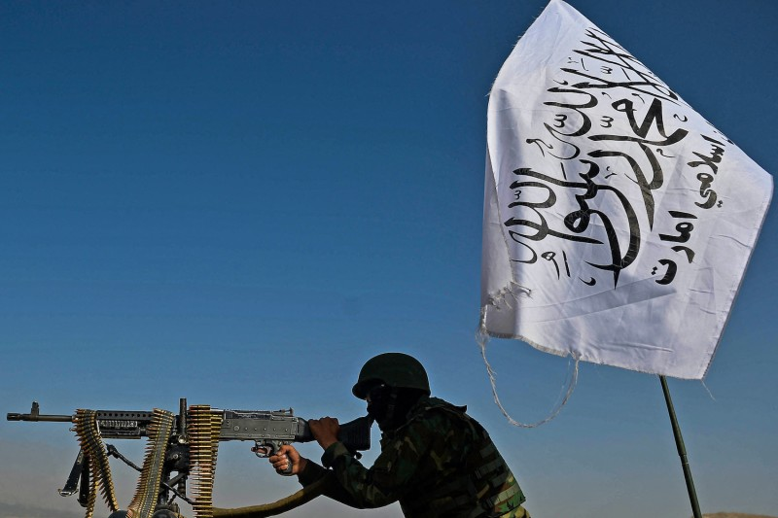
The Question of Afghanistan – Addressing the Taliban Regime

Slide 6
Committee: The United Nations Security Council
Topic: The Question of Afghanistan – Addressing the Taliban Regime
Author: Sushant Sahani
Introduction
The Taliban Regime first ruled over Afghanistan in 1999. The Taliban regime, during this time, was oppressive by imposing laws drawn from tribal codes under the strict interpretation of Islam. Two decades later the Taliban have taken control again. Dating back to 1979, the Soviet Union invaded Afghanistan to show support to the Communist Afghan government which was an ally of the Soviet Union. However, the Afghans were not an ally to the Afghan Government.
Afghanistan is a deeply divided nation since major cities like Kandahar are scarcely population. The majority of the population resided in local areas where the people are in poverty, conservative, and strict followers of Islam. For many Afghans in this region, authority came from the tribal leaders of their respective ethnic groups instead of the government. Opposed to this regime, the Afghans revolted and formed a militia, collectively known as the Mujahideen. The Soviet troops had pounded the countryside with force which galvanized more people to join the militia. Many surrounding States, including the US, started funding and supplying to the Mujahideen. When the Communist government fell, and the Soviet Union troops left, the Mujahideen resisted each other and sparked a civil war.
In 1994, the locals of the Singesar in the Kandahar region initiated a group to drive out the Mujahideen, under the leadership of Mullah Mohammed Omar. As more students and teachers (Mullahs) joined the group, they captured the entire city of Kandahar. This group came to be known as the Taliban. Since the fighters of the Taliban were mostly of the Pashtun ethnic group, it made it easy from them to capture most of the Pashtun-occupied regions as they gathered immense support from the people. Although the Taliban had captured most of the territories, there was still threatened by the remaining Mujahideen groups. In order to combat this Pakistan had supplied tons of weapons. In 1996, the Taliban were able to capture Kabul and, hence set up a new government. The laws set up were inspired by a certain interpretation of Islam that was popular in the Pashtun group.
After it was discovered that the wanted terrorist Osama Bin Laden was in Afghanistan, the Taliban government refused to surrender the terrorist which deemed Afghanistan responsible for any attacks in the US.

Slide 7
In order to combat this Pakistan had supplied tons of weapons. In 1996, the Taliban were able to capture Kabul and, hence set up a new government. The laws set up were inspired by a certain interpretation of Islam that was popular in the Pashtun group.
After it was discovered that the wanted terrorist Osama Bin Laden was in Afghanistan, the Taliban government refused to surrender the terrorist which deemed Afghanistan responsible for any attacks in the US.
After the September 11 attacks in the US, a US-led coalition force invaded Afghanistan to find Bin Laden. With the help of the remaining groups of the Mujahideen, the force was able to capture Kabul from the Taliban. Bin Laden and the Taliban leaders escaped, while most fighters went hiding in rural Afghanistan. The US and UN worked to set up a democratic Afghan Government and Army, and the Mujahideen run the local governments. Billions of funds were legitimately supplied to this government for building important facilities in the cities and rural areas. In 2003, the US invaded Iraq and a lot of the funds were diverted to support this.
In 2004, the Taliban leadership regrouped and started recruiting fighters, but this time they attracted other ethnic groups as well instead of predominantly Pashtun fighters from rural Afghanistan. The Taliban were targeting US, NATO, and Afghan troops with sophisticated tactics of war. The trained and new Taliban were able to control the majority of rural Afghanistan due to the enlisting of diverse ethnic groups.
In 2012, the US-led coalition reduced its troops and relied on the Afghan Government and Army to lead the fight. But there was distrust in this government which allowed the Taliban to govern their territories. This version of the Taliban was different in the mid-’90s, as the rules of governance were pragmatic in certain regions and conservative in other regions.
In 2020, the US entered a deal with Afghanistan to retract their troops from Afghanistan, and in 2021, the final troops pulled out and the Taliban attacked. The Afghan army surrendered, the government fled, and the Taliban entered Kabul. In September 2021, the Taliban announced a new interim government.

Slide 8
Explanation of the Problem
When the Taliban first gained control of Afghanistan, the government was inexperienced and extremely oppressive. They introduced laws that were against rights of women and minorities, entertainment, physical appearance, and the punishments for breaking the law were inhumane such as stoning, and public executions were common under the Taliban regime. With reports instigating that Osama Bin Laden was in Afghanistan and refused to extradite him to the US, they invaded Afghanistan. But this man-hunt resulted in a massive war that killed many innocent civilians. The Afghan government that the US and UN worked to set up was heavily corrupt. The billions of dollars that were provided to the government for rebuilding the nation weren’t utilized properly. Construction projects, roads, highways, facilities were barely made and only found in the cities while rural Afghanistan was left unattended and became a subject to the attacks by the US-led coalition force.
The Taliban government that recently gained control of Afghanistan again is found to be varying in terms of their policies across Afghanistan. This time, consisting of various ethnic group, it is hard to predict how the Taliban regime may include the different views of ethnic groups and implement its policies. The courts of Afghanistan are regulated by people with almost no legal experience and the accused rarely get represented by educated lawyers. Whereas for the funding of the government, the Taliban heavily relies on taxing the major highways and the large opium growing fields. After announcing the new government, the Taliban has asked for international recognition. While most of the international community is against the recognition of the Taliban because of their method to rise to power, and their treatment of the Afghan civilians. But it is also important to note that Afghanistan is under poverty and food crisis. With the humanitarian crisis on the rise in Afghanistan, the international community may be obligated to provide relief from the situation. Many members want the Taliban to allow safe passage for people wishing to leave the country, respect the basic human rights especially of women and children, and prevent Afghanistan from becoming an incubator of global terror again in order for diplomatic recognition to be on the table.

Slide 9
Focus of the Debate
Looking forward to the conference, the focus of the debate must surround the question of international recognition of the Taliban regime and whether this will be an important step in ensuring peace and security within Afghanistan.
Afghanistan is a highly volatile region. The international community must seek solutions in order to prevent a civil war again on Afghan soil by means of corruption, abuse of power, violations of basic human rights, and violence by weapons. There should be an important step to curb the availability and sale of billions of weapons left by the previous invading forces. The acquirement of government funds for utilities and armies also raises an issue as the production of opium is a threat to public health. There must be appropriate measures in place to establish a safe and effective government that prioritizes the development of major cities as well as the rural areas, and transparency in its operations to which it can gain the confidence of the people. It is important to note that the discussions, in regard to the state of Afghanistan, where the sovereignty of the nation and territorial integrity is hurt, are prevented so as to avoid any conflict that may pose a threat to peace and national security.
The question of diplomatic recognition of the Taliban regime is a controversial one, and during discussions, the members must address the issues that prevent a peaceful settlement between the international community and the ruling Taliban regime. Members must discover whether Afghanistan under the Taliban regime meets the necessary criteria in order to qualify as a state under international law. Due to the nature and the diversity of the Taliban regime, there exists a repulsion between the cabinet members and the people, which may signal the oncoming of a dire crisis in an already devastated region, hence the international community must suggest strong resolutions to aid the inexperienced Taliban regime in establishing a positive image with the community and the people of Afghanistan.

Slide 10
Questions to Consider
Can Afghanistan under the Taliban regime be considered a state under International Law?
Was there a constitutional transition to power between President Ashraf Ghani and Vice-President Saleh? If so, does it allow the Taliban to govern the nation?
Addressing the members of the Cabinet, can the cabinet of the Taliban be considered a legitimate cabinet despite of the presence of certain members?
How should topics such as protection of women’s and minority’s rights be introduced while negotiating with the Taliban?
What measures need to be discussed in order to reduce the levels of drug trafficking and corruption within Afghanistan and its government?
The presence of billions of military-grade weapons provokes a threat to the national security of Afghanistan. What should be done to prevent the misuse of these weapons?

Slide 11
Recommended Readings & Bibliography
“https://crsreports.congress.gov/product/pdf/R/R46955”
“https://www.iss.europa.eu/sites/default/files/EUISSFiles/Brief_5_Afghanistan.pdf”
“https://rsilpak.org/wp-content/uploads/2021/10/afghanistan-taliban-
recognition_rsil.pdf”
“https://www.youtube.com/watch?v=1_a0ySeaQ-8”
“https://www.usip.org/publications/2022/02/afghan-taliban-views-legitimate-islamic-governance”
“https://2001-2009.state.gov/g/drl/rls/6185.htm”
“https://www.mei.edu/publications/taliban-unrecognized-and-unrepentant”
a

Slide 12
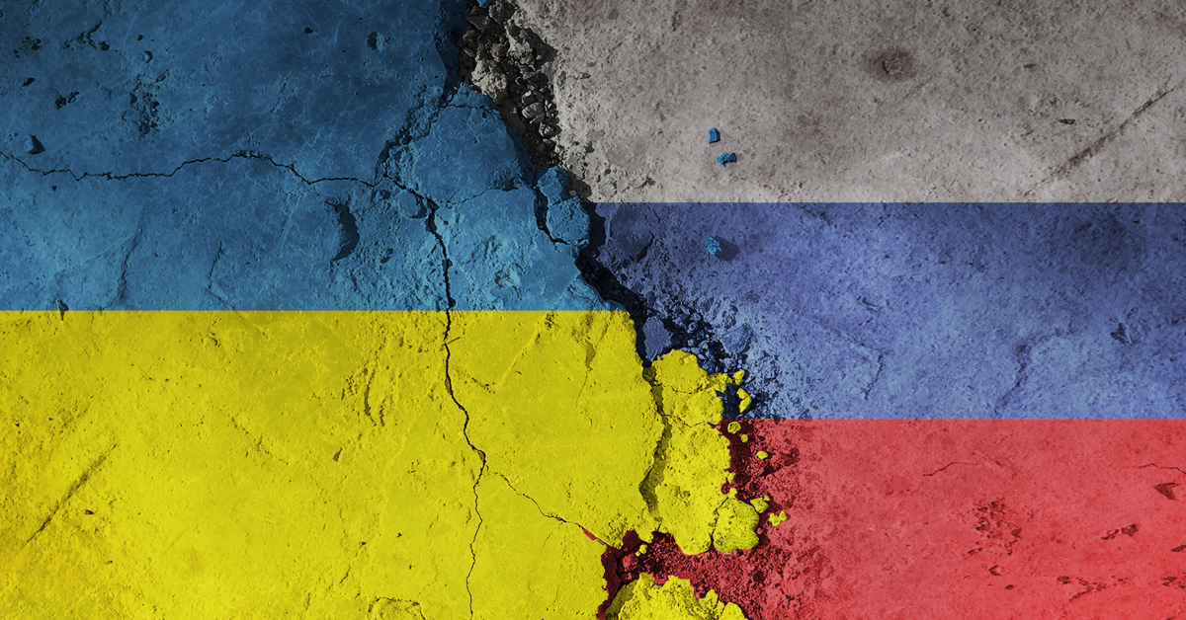
The Ukraine – Russia Conflict

Slide 13
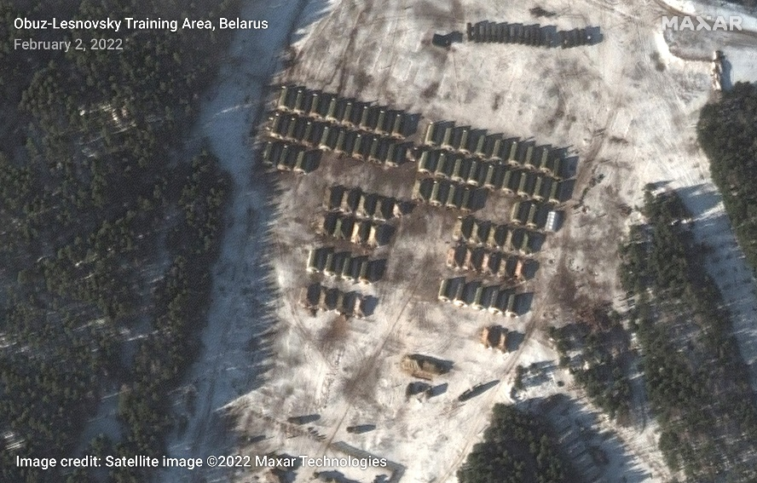
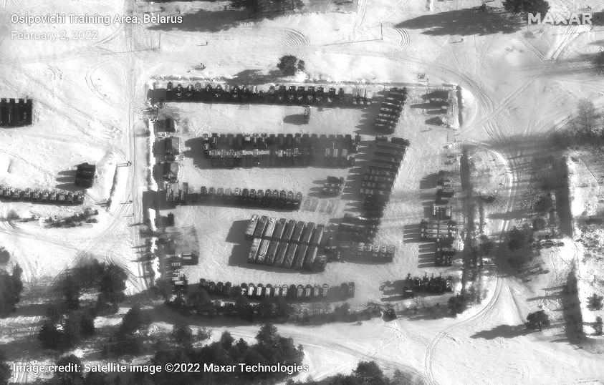
Committee: The United Nations Security Council
Topic: The Ukraine – Russia Conflict
Author: Adhil Sajin Sha
Introduction
The Ukraine – Russia conflict is an ongoing issue that was brought to attention very recently despite it being an old issue. The reason for such a burst in attention from the international community all of a sudden is due to the steps taken by Russia that sparked protests around the world. Russia sees itself responsible for what modern Ukraine looks like today and has been intimidated by NATO countries that have been coming closer and closer to Russia’s borders. Which ultimately led to Putin putting his special military operation into force and invading Ukraine.
The issues behind the conflict date back to the 19th century and the fall of the soviet union. Historic and geographical circumstances are the 2 main factors that have been involved and the motive behind it is control and influence over certain regions, as Russian leader, Vladmir Putin states “Russia and Ukraine aren’t just neighbors, we are one nation”.

Slide 14
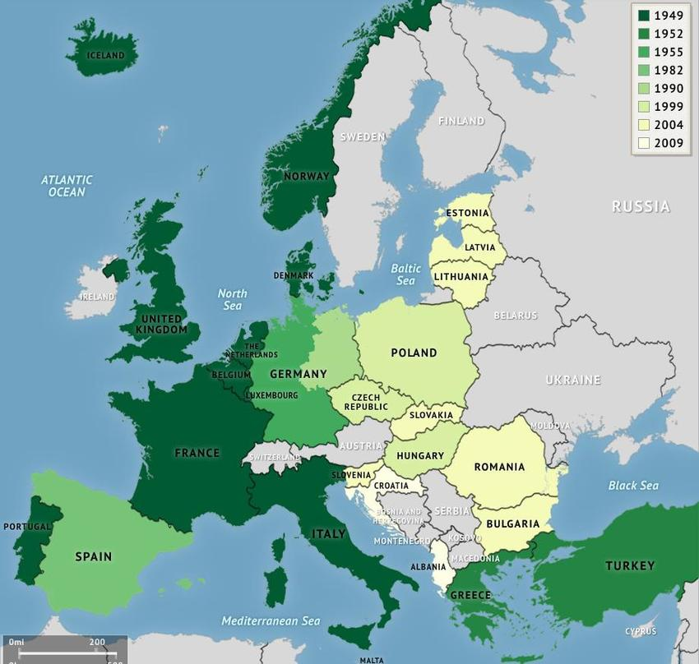
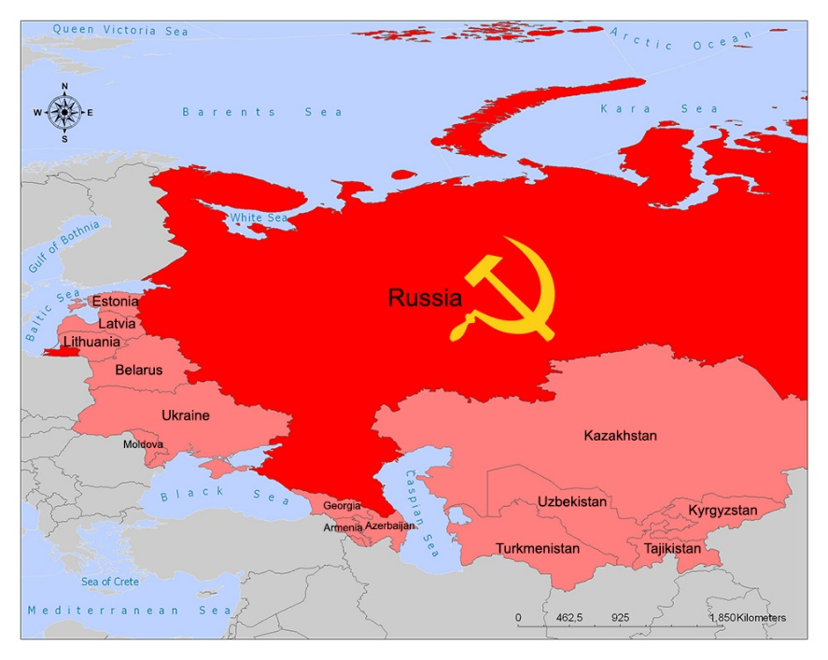
Explanation of the Problem
In the beginning Ukraine was ruled by Viktor Yanokovych who turned down being a member of NATO to strengthen ties with Russia, but this was met with immediate backlash from the people within Ukraine who put up posters saying, “Ukraine does not belong to Putin”. These protests ultimately fueled the tension between the president and its people until finally Viktor Yanokovych opened fire killing hundreds of innocent peaceful protesters and eventually this led to him fleeing the country in February 2014. To understand why Russia has an issue with Ukraine joining NATO we have to go back to the 19th century, back when the soviet union was present, there were a few countries that stood in between the western powers and the soviet union, these mainly included Georgia, Ukraine and Belarus who came under the influence of the soviet union but later overthrew their communist governments.

Slide 15
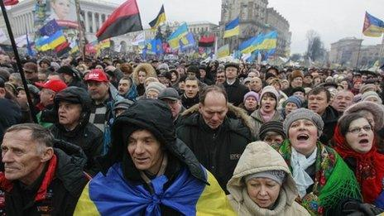
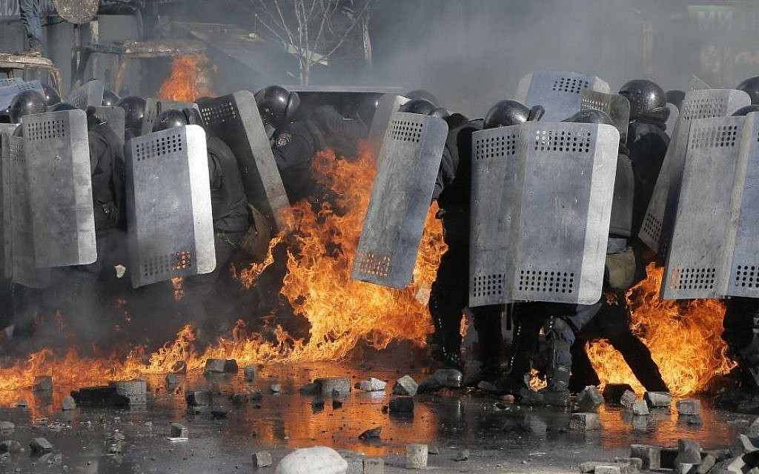
Explanation of the Problem
Since the western side and the soviet union had contradicting ideologies, they ultimately hardened their military and all NATO members pledged to protect each other from invasion. Eventually in 1991, the soviet union collapsed but NATO was still going strong and infact expanded over the area that Russia previously had influence over. Now Belarus, Georgia and Ukraine were the only nations that stood between NATO and Russia. Both Georgia and Ukraine showed interest in joining NATO which made both these nations prime targets for Russia. Ukraine partnered with NATO in 1994 which made them a step closer to becoming a member of NATO but when it was time to sign the association agreement in 2013 the pro Russian government that ruled Ukraine refused and sided with Russia which led to the protests and removal of Viktor Yanokovych as mentioned previously.

Slide 16
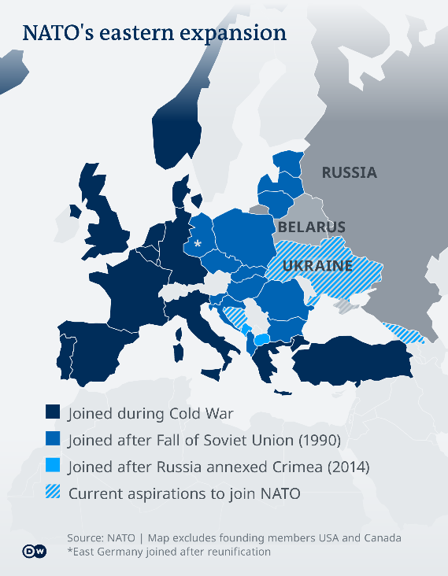
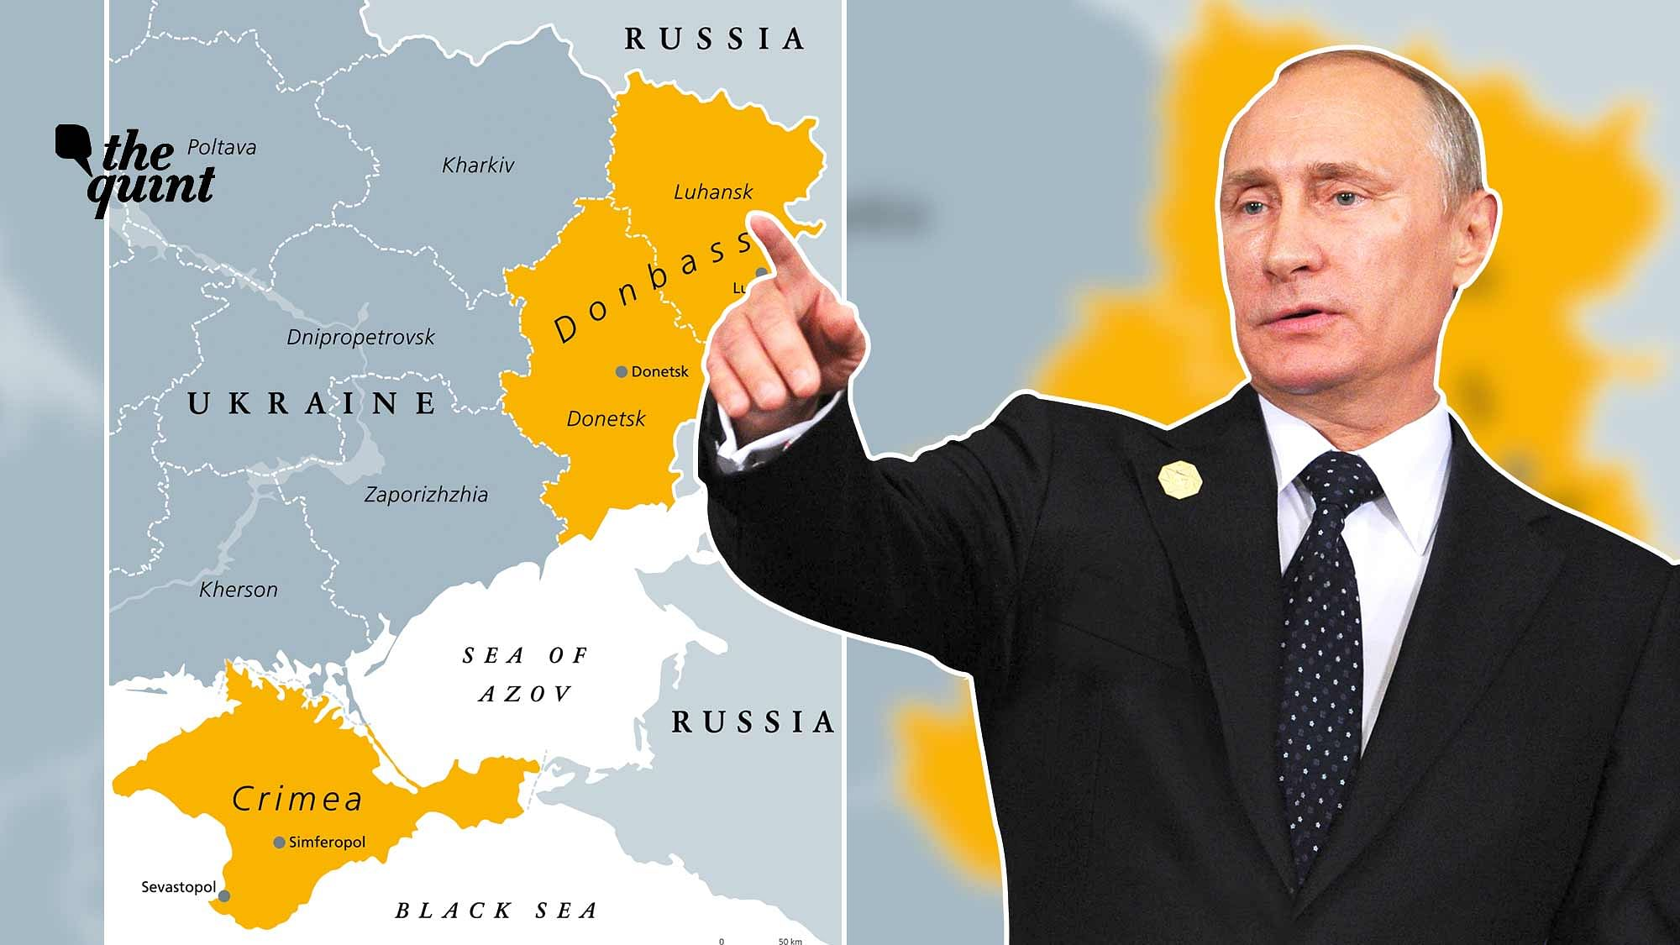
Explanation of the Problem
Seeing how Russia was losing its political influence over Ukraine, Putin decided to use brute force. First the Crimean peninsula was annexed by Russia. Then following that they captured 2 regions in Ukraine, Donetsk and Luhansk, stating that they were independent of Ukraine rule. This conflict then went on and over 14,000 people were killed and over 2 million people displaced. Advancements to the issue came in November 2021 when Putin decided to increase military presence near the borders of Ukraine and denied all allegations of the invasion until he introduced his demands to the west. He had 2 main demands, firstly for NATO to stop expanding and the second was for NATO to move their military back to where it was back in 1997. The western powers however rejected his demands and reinforced military power in the eastern side which increased tensions.

Slide 17
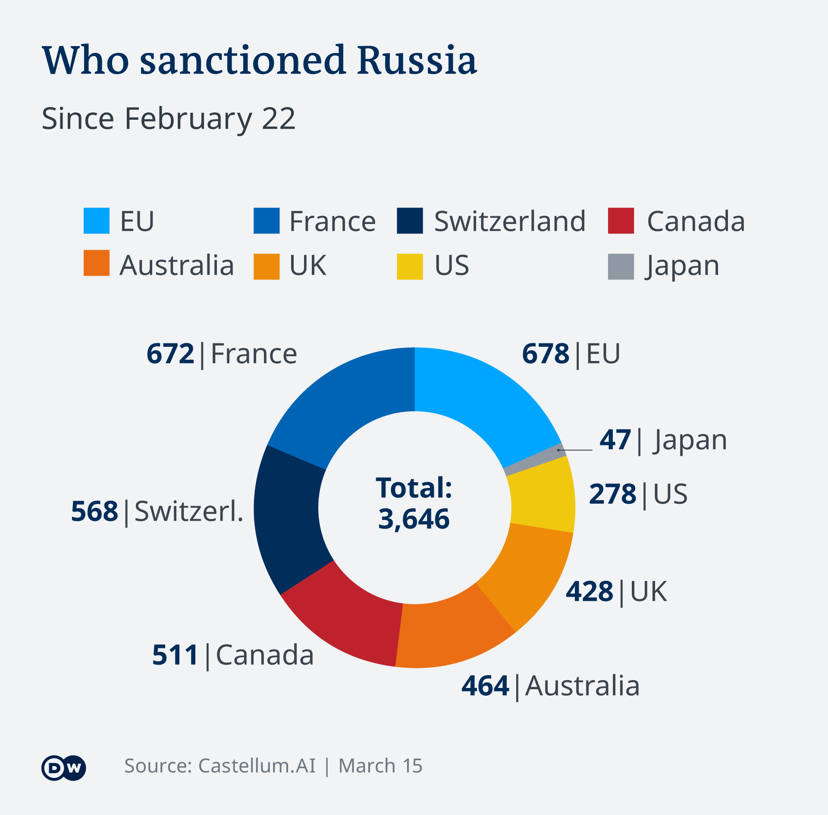
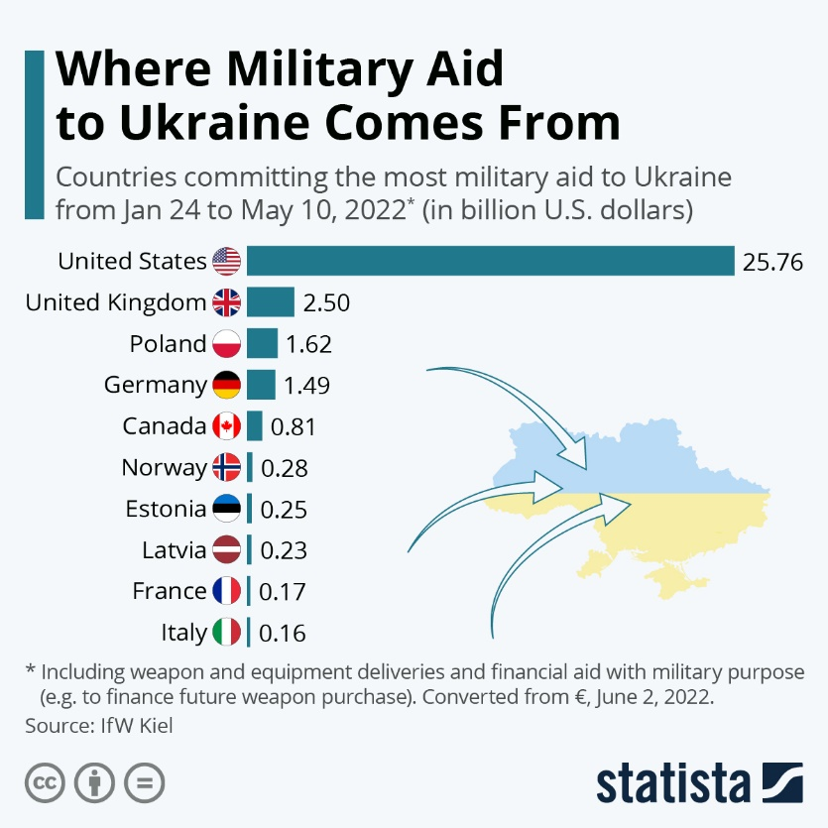
Explanation of the Problem
On February 24th, 2022, Putin began the invasion of Ukraine and called it a special military operation. The international community condemned his actions and sent in resources, but Russia then stated that anyone else who intervenes will face consequences. Russia holds one of the largest active nuclear arsenals in the world and things could go out of hand if not controlled properly.
Harsh sanctions were imposed on Russia to slow Putin down, but Russia still goes deeper in Ukraine and Ukraine keeps fighting harder.

Slide 18
Focus of the Debate
The main focus of this debate should not revolve around who is right or who is wrong but rather what can both parties sacrifice to come to a common ground taking in historic stances and find common ground to solve the issue at hand. However, the emphasis and importance should be given to protecting the people of Ukraine who are dying because of the lack of stability within the region. Ways to instill peace, security and stability have to be brought about while also keeping in mind not to increase tensions further as Russia holds one of the largest active nuclear arsenals.
Should nuclear arsenal be called upon during such unprecedented times as other nations try to help their allies whether it be in military aid and or humanitarian aid. As there are various ways in which nations can respond to issues that put the security and international peace at risk.
Can solutions that be introduced here be applicable for similar conflicts that differ geographically and historically such as the Israeli-Yemen conflict. Will the active coverage of this issue world-wide cause more harm than good? How can stability be brought out without the intervention of foreign powers.

Slide 19
Questions to Consider
Can and should the international community intervene directly in this matter?
Could the ongoing issue escalate to the formation of a modernised soviet union or the dissolution of Russia?
How can the people affected in this war be protected?
Should NATO take into account Russia’s demands?
How can nations be assured that Russia will not operate its nuclear arsenal till the war be put to an end, which may be an unfavourable ending to Russia’s demands?

Slide 20
Recommended Readings & Bibliography
https://www.reuters.com/world/europe/extracts-putins-speech-ukraine-2022-02-21/
https://www.reuters.com/world/europe/putin-has-deployed-nearly-100-pct-pre-staged-forces-into-ukraine-us-official-2022-03-07/
https://www.dw.com/en/ukraine-and-russia-hold-third-round-of-talks/a-61039008
https://www.euractiv.com/section/global-europe/news/russian-general-says-moscow-aim-is-to-leave-ukraine-as-a-landlocked-country/
https://edition.cnn.com/europe/live-news/ukraine-russia-news-02-23-22/h_d115a65e9b6348752422ad427fa83b95
https://tass.com/world/738110?utm_source=en.wikipedia.org&utm_medium=referral&utm_campaign=en.wikipedia.org&utm_referrer=en.wikipedia.org
https://edition.cnn.com/europe/live-news/ukraine-russia-news-02-23-22/h_82bf44af2f01ad57f81c0760c6cb697c
https://www.reuters.com/article/us-ukraine-crisis-tanks-exclusive-idUSKCN0IC1GE20141023

